Slide 1
FUNCTIONAL FOCUS
Notes:
https://icc.academy/cftp-gtc-cdcs-csdg-citf-holders/

Slide 2
Revision History
Revision History
Author | Date | Version | Comments
Vivek Mohan | 07 Feb 2023 | 0.1 | Last Update on 07 Feb 2023
Yogesh Gadepalli |  |  | Reviewed & approved

Slide 3
Contributors
Revision History
Participants | Date | Version | Comments
Bhuvaneswari Sundaram |  |  | Last Updated on 07 Feb 2023
Bagyalakshmi Narasiman
Nivetha Venkatachalam
Pooja Gupta
Yenduva Suresh Kumar
 |  |  | Reviewed & approved

Slide 4
Functional Coverage
Revision History
Domain | Topic | Slide Reference | Contributor
1. Introduction to Trade Finance | Trade and Trade Finance |  | Vivek, Suresh and Bhuvneswari
 | Settlement Arrangement and Types
 | Risk in Trade Finance
2. Letter of Credit | Definition |  | Vivek, Suresh and Bhuvneswari
 | Risk Covered in L/C
 | Types of Letter of Credit
 | Letter of Credit Life Cycle and Activities
 | UCP 600 and ISBP
3. Collection | Definition |  | Suresh
 | Difference with L/C
 | Collection Life Cycle and Activities

Slide 5
Functional Coverage
Revision History
Domain | Topic | Slide Reference | Slide Reference
5. Payments | Collection Payments |  | Pooja
 | LC Payments |  | Bagyalakshmi
4. Guarantee | Definition |  | Vivek and Bhuvneswari
 | Types of Guarantee
 | Guarantee Life Cycle and Activities
 | Invocation and Payment
5. Supply Chain Finance | Definition |  | Nevetha
 | Type of Products

Slide 6
Abbreviation, Notation
L/C - Letter of Credit
CC - Cash Credit
OD - Over Draft

Slide 7
Introduction to Trade Finance
Revision History
What is trade ?
Trade - Voluntary exchange of goods or services between different economic actors
Economic Actors - Buyer, Seller
Geography - Inland and Cross Border
Currency - Home Currency , Foreign Currency
Nature of Underlying Needs - Goods or Services
Notes:
References :
https://www.investopedia.com/
Experience based Information

Slide 8
Introduction to Trade Finance
Revision History
Types of Trade
Domestic Trade is the purchase and sale of goods within the same country and results in the movement of goods within the country.
International Trade is the purchase and sale of goods between two countries and results in the movement of goods from one country to another country.
Notes:
References :
https://www.investopedia.com/
Experience based Information

Slide 9
Introduction to Trade Finance
What is Trade Finance ?
The term "Trade Finance" - Umbrella term for products offered by banks to mitigate risk between parties for predictable and secured world trade
WTO - 80 to 90 % of Global Trade is via Trade Finance
Notes:
Reference :
WTO | Trade finance
Access to trade finance - ICC - International Chamber of Commerce (iccwbo.org)

Slide 10
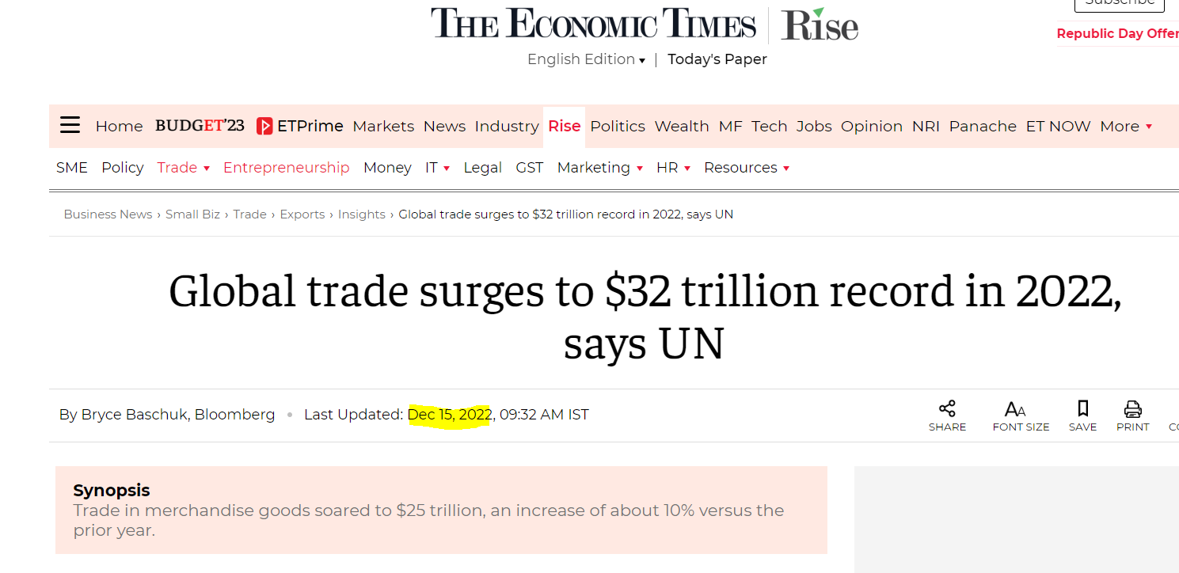
Introduction to Trade Finance
Volume of Trade

Slide 11
Introduction to Trade Finance
Examples of financial instruments
Letters of credit
Factoring is when companies are paid based on a percentage of their accounts receivables.
Export credit or working capital can be supplied to exporters.

Slide 12
Introduction to Trade Finance
Settlement Arrangement and Types
1.Open Account - Real Life Example : Amazon COD
2.Consignment Account - Importer is middlemen
3.Collection
4.Letter of Credit
5.Advance Payment - Real Life Example : Booking Plots / Prepaid
Notes:
Reference:
https://www.wallstreetmojo.com/consignment-accounting/#h-what-is-consignment-accounting
Methods of Payment (trade.gov)

Slide 13
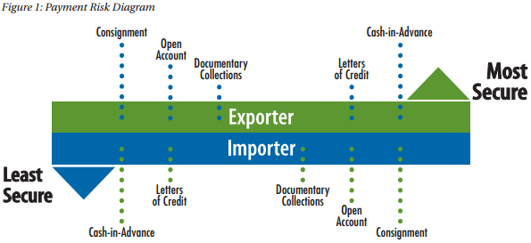
Risk Involved in Trade Finance
Pictorial Representation of Risk between Parties

Slide 14
Documentary Credits

Slide 15
Learning Objectives
Main types, characteristics, and uses of documentary credits
Slide 16 - 21
Roles and obligations of the parties to documentary credit transactions and the relationships between them
Slide 22-37
Types of transport, commercial and financial documents used in documentary credit transactions and their requirements under ICC rules
Slide 38 - 52
The related products used in documentary credit transactions
Slide 110-114
Industry rules, standards, guidelines, and trade terms that govern the delivery of documentary credit transactions
Slide 54-67
The ways in which documentary credit transaction rules and regulations can be breached and the implications of such breaches- slide 115-117
The processes and challenges involved in documentary credit transactions -68-105
The risks involved in documentary credit transactions – slide 71-74
appropriate rules and trade terms to documentary credit transactions
accuracy of documents used in documentary credit transactions

Slide 16
Documentary Credit (LETTER OF CREDIT)
What is Letter of Credit ?
Credit means any arrangement, however named or described, that is irrevocable and thereby constitutes a definite undertaking of the issuing bank to honour a complying presentation.
A documentary credit is an irrevocable undertaking issued by a bank whereby it undertakes to make payment to a named beneficiary, provided that the documents stipulated in the documentary credit are presented, and all of its terms and conditions are complied with.
Honour - Pay at Sight, Incur Deferred payment/accept draft with payment on maturity
Notes:
Reference :
1.UCP 600

Slide 17
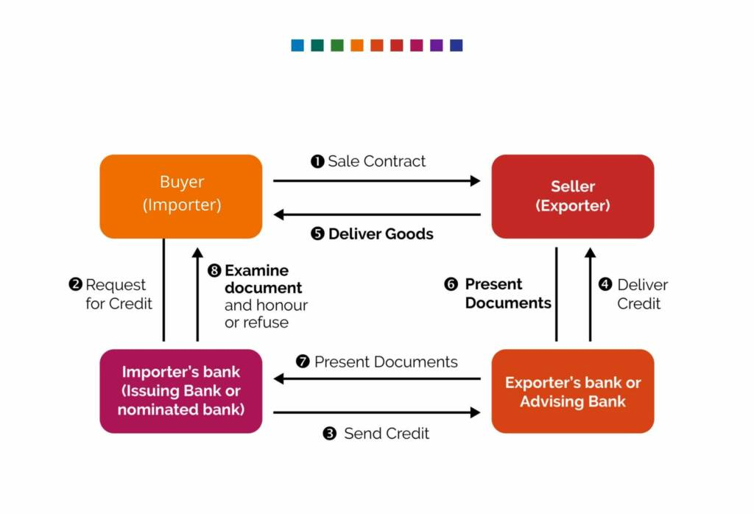
Letter of Credit – Basic Life Cycle
1. Applicant applies to its bank to issue a documentary credit, usually by completing the bank’s standard application form.
2. The buyer’s bank transfers the LC to the advising bank in the seller’s country.
3. After checking authenticity of the letter of credit, the advising bank forwards it to the exporter. The seller now reviews the terms & conditions mentioned in LC and notify any required amendment to the buyer.
4. Once terms & conditions of trade are finalised and agreed, the seller makes merchandise ready for shipment to the appropriate destination. The seller obtains required transport documents like Bill of Lading, while shipping the goods.
5. Now seller presents the shipping documents to the Negotiating Bank, indicating complete compliance with the terms of the letter of credit. The job of Negotiating Bank is to review these documents and dispatch these to the Issuing Bank. The Negotiating Bank also raises a reimbursement claim to the Reimbursing Bank.
6. Once Issuing Bank receives all documents, importer has to make the payment to bank and will receive the documents, which will make him to take the shipment into possession.

Slide 18
Letter of Credit – Types and characteristics (Primary)
Type of LC | Description
Revocable LC | Revocable LC is a credit, which can be revoked. i.e. cancelled or amended by the bank issuing the credit, without the notice of other parties (rarely used)
Irrevocable LC | Irrevocable LC is a firm undertaking on the part of Issuing Bank and cannot be cancelled or amended without the consent of the parties. (more favorable)
Confirmed LC | Confirmed LC is a LC to which another bank has added its confirmation or guarantee.
Sight credit and Usance Credit | Sight credit states that the payment would be made by the Issuing Bank at sight, on demand or on presentation. In case of usance credit, drafts are drawn on the issuing bank or the correspondent bank at specified usance period
Back to Back LC | one LC is opened with security of another LC
Standby LC | These credits are generally used as a substitute for performance guarantee.
Notes:
Reference :
https://efinancemanagement.com/sources-of-finance/types-of-letter-of-credit-lc#Red_Clause_LC

Slide 19
Letter of Credit – Types and characteristics (Secondary)
Type of LC | Description
Revolving LC | A documentary credit that revolves, in terms of time or value, is generally issued when an applicant and beneficiary have a long-standing repetitive trading relationship and experience in the shipment of the goods described in the documentary credit.
Instalment | If an application form requires the documentary credit to stipulate that shipment of goods should be made in accordance with a stated instalment schedule, the exact needs with regard to delivery of the goods should be ascertained. This will ensure that the documentary credit, when issued, accurately reflects these needs – particularly in respect of partial shipments and the continued availability of the documentary credit in the event of failure by the beneficiary to adhere to the instalment schedule. (Article 32)
Advance Payment | The issuing bank incorporates a clause in its documentary credit authorising the nominated bank to pay a specific amount, or a percentage of the value of the documentary credit, to the beneficiary in advance of any shipment, or provision of any services or performance.
Transferable Credits | A transferable documentary credit is one wherein it could be transferred to one or more second beneficiaries at the instructions of the first beneficiary.
Evergreen | Given the long-term expiry nature of SBLCs, they often insert what is commonly referred to as an “Evergreen” or “automatic-extension” clause. The Evergreen Clause allows an SBLC’s expiry date to automatically extend for a fixed period-of-time (e.g. every six months or year).

Slide 20
Letter of Credit – Types and characteristics (Secondary) cont.
Type of LC | Description
Clean LC | A letter of credit issued by a bank against which the designated foreign seller may draw a bill without documentary support. The issuing bank engages to accept a clean bill, if otherwise drawn in accordance with the conditions imposed by the relative letter of credit.
Direct Pay | A Direct payment letter of credit is a special form of standby letter of credit. Its working mechanism closely resembles that of a standby documentary credit. The primary purpose of a direct payment LC is to secure the buyer from non-performance risk.

Slide 21
Standby Letter of Credit
Normally a substitute for Bank Guarantee.
Operates like a Commercial Letter of Credit, except that typically it is retained as a "standby" instead of being the intended payment mechanism. UCP600 article 1 provides that the UCP applies to Standbys; ISP98 applies specifically to Standby letters of Credit; In 1998 the International Chamber of Commerce (ICC) added ISP98 (International Standby Practices 98 89 Articles) as the rules to guide standby letters of credit, since in UCP600 there is only 1 Article which may not be enough for a Standby Transactions.
The ISP98 rules are slowly being adopted; however, many of the standby letters of credit continue to rely on the ICC’s older guide, UCP600.
Such LCs is opened mostly by banks in countries where, by law, they are prohibited from issuing Guarantees (e.g., USA) and the countries where they don’t use Standby as per ISP98.
Is invoked in case of non-performance of the contract.
Documents to be presented under the SBLC are normally very minimal.

Slide 22
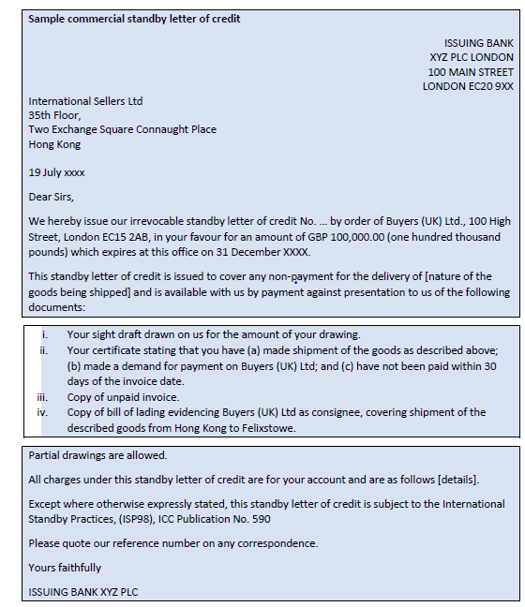
Standby Letter of Credit- Sample

Slide 23
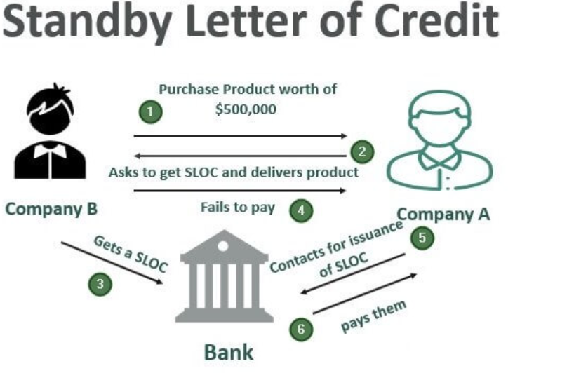
Standby Letter of Credit- Example
-Company A sells TVs, and company B wants to purchase $500,000 worth of their product. Since they’ve never done business before, Company A wants to protect themselves and asks the buyer to get a standby letter of credit.
-Company B goes to its bank and gets a SLOC.
Company A delivers the TVs to Company B and gives them 30 days to pay for the goods. Company B fails to pay for TVs within 30 days. After not receiving payment, Company A contacts the bank that issued the SLOC, informing them that they were never paid for their product. They submit the necessary documentation as per SLOC agreement, and the bank pays them what they’re owed.
-For a seller, a SLOC offers exceptional protection and makes completing a business deal a no-brainer. Only catch here being, the seller must follow the agreement in the SLOC precisely. For example, if the $500,000 worth of TVs Company B bought were supposed to be 42” and black, and that was in agreement, but what they received were 36” and grey, that would be a failure to meet the specific terms.

Slide 24
Parties to documentary credits roles and responsibilities
Applicant (buyer/importer)
“Article 2 defines an ‘applicant’ as the party on whose request the credit is issued.”
The Person who makes the application to the bank for opening the letter of credit.
Normally the importer / buyer of the goods.

Slide 25
Parties to documentary credits roles and responsibilities
Issuing Bank (Opening Bank):
“Article 2 defines an ‘issuing bank’ as the bank that issues a credit at the request of an applicant or on its own behalf.”
An issuing bank issues its documentary credit in favour of a beneficiary.
Normally the buyer’s / importer's bank.
Normally based in the country of residence of the importer.
It incorporates its irrevocable and independent undertaking to honour – that is, to pay, to accept a draft and pay at maturity, or to incur a deferred payment undertaking and pay at maturity – provided that: (i) all documents, as stipulated in the documentary credit, are presented; and
(ii) the beneficiary has complied with all of the terms and conditions of the documentary credit.

Slide 26
Parties to documentary credits roles and responsibilities
Beneficiary (seller/exporter)
“Article 2 defines a ‘beneficiary’ as the party in whose favour a credit is issued.”
Party in whose favor the letter of credit has been established.
Normally the exporter / seller of the goods.
Following shipment or dispatch of the goods, or when the required service or performance has been provided, the beneficiary will issue, collate and present the stipulated documents to the issuing bank, a confirming bank (if any), or a nominated bank for honour or negotiation.

Slide 27
Parties to documentary credits roles and responsibilities
Advising Bank -
“Article 2 defines an ‘advising bank’ as the bank that advises the credit at the request of the issuing bank.”
Bank which advises the letter of credit to the beneficiary.
Normally the bank located in the country of the beneficiary (exporter).
Validate the genuineness (authenticity) of the LC before advising the same to the beneficiary.
A credit and any amendment may be advised to a beneficiary through an advising bank. An advising bank that is not a confirming bank advises the credit and any amendment without any undertaking to honour or negotiate.
An advising bank may utilize the services of another bank ("second advising bank") to advise the credit and any amendment to the beneficiary.
A bank utilizing the services of an advising bank or second advising bank to advise a credit must use the same bank to advise any amendment thereto.

Slide 28
Parties to documentary credits roles and responsibilities
Confirming Bank -
“Article 2 defines a ‘confirming bank’ as the bank that adds its confirmation to a credit upon the issuing bank’s authorization or request.”
Bank with which the credit is available or any bank in the case of a credit
available with any bank.
Definite undertaking of the confirming bank, in addition to that of the issuing bank, to honour or negotiate a complying presentation
It is common for a confirming bank to also act in the role of advising bank and nominated bank, but this is not an absolute requirement of UCP 600.

Slide 29
Parties to documentary credits roles and responsibilities
Nominated Bank –
“Article 2 defines a ‘nominated bank’ as the bank with which the credit is available or any bank in the case of a credit available with any bank.”
The Negotiating or Nominated Bank where an exporter can negotiate the credit without any restriction.
Nominated bank can prepay or purchase accepted draft/ deferred payment undertaking

Slide 30
Parties to documentary credits roles and responsibilities
Reimbursing Bank –
“Sub-article 13(a) reimbursements describes a ‘reimbursing bank’ as the bank named in a documentary credit upon which the nominated bank (the ‘claiming bank’) may claim in respect of any honour or negotiation that it has effected to the beneficiary..”
Bank instructed or authorized to provide reimbursement pursuant to a reimbursement authorization issued by the issuing bank.
Transferring Bank-
‘transferring bank’ as a nominated bank that transfers the credit or, in a credit available with any bank, a bank that is specifically authorized by the issuing bank to transfer and that transfers the credit. An issuing bank may be a transferring bank.

Slide 31
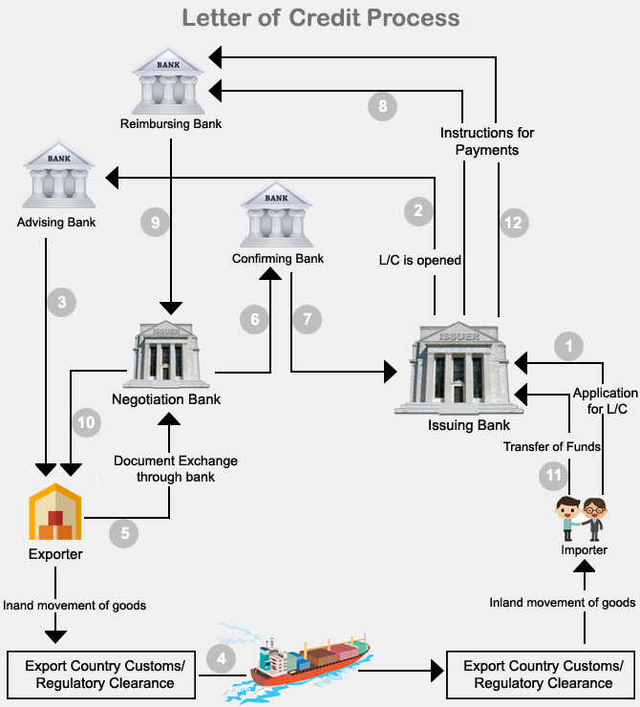
Letter of Credit – Relationship of parties
The contract is agreed between the buyer (‘applicant’) and seller (‘beneficiary’) indicating a documentary credit as the method of settlement
Applicant applies to its bank to issue a documentary credit, usually by completing the bank’s standard application form.
Subject to a credit facility being in place and the bank agreeing to the terms and conditions that have been stated in the application form, the bank issues the documentary credit and advises it through a bank in the country of the beneficiary, known as the ‘advising bank’.
Advising bank issues its documentary credit advice and sends it to the beneficiary.
The beneficiary, if in agreement with the terms and conditions of the documentary credit, arranges shipment of the goods.

Slide 32
Letter of Credit – Relationship of parties
6. Having shipped the goods, the beneficiary issues, collates and presents the documents in the documentary credit to the advising bank, which is also the ‘nominated bank’.
7. Because the advising bank has not added its confirmation to the credit, it may or may not examine the documents prior to sending them to the issuing bank. It is also under no obligation to honour or negotiate the beneficiary’s documents. We will assume that the advising/nominated bank has not examined the documents.
8. Issuing bank determines that the documents comply and the applicant’s account is debited for the value of the drawing. The documents are handed over to the applicant so that it may take control of the goods. Issuing bank reimburses the advising/nominated bank.
9. Advising/nominated bank, receives the proceeds from the issuing bank, and makes settlement to the beneficiary, as requested.

Slide 33
LC Confirmation
The concept of confirmation should be understood in the context that whereas the issuance of a documentary credit, by an issuing bank, removes the payment risk of the applicant, the adding of confirmation removes the payment risk of the issuing bank.
In most cases, it is the advising bank that will be the bank that is authorised or requested to add its confirmation.
We can identify confirmation on LC by checking clause F49 in SWIFT MT700 that is confirmation instruction. Wording in this clause may be- Without, Confirm or May Add.
The wording “May Add” denotes the Letter of Credit is unconfirmed but it provides permission to the seller to add an additional undertaking namely confirmation& it’s totally seller option.
The confirmation to the letter of credit is made by the confirming bank upon request of the LC issuing bank based on buyer’s application according to the contract between seller & buyer.
Also, a without confirm LC can be confirmed by the seller’s bank upon request of the seller at his own cost.
Normally, the seller prefers to get confirmation from the LC advising bank or any bank in the seller’s country.
bank authorised or requested to add its confirmation is under no obligation to do so. If it decides not to add its confirmation.
Notes:
UCP 600 - Article 8

Slide 34
LC Confirmation- Cont.
There are several reasons why a bank may not be prepared to add its confirmation. Some of the more common ones are that:
the limit available under its own guidelines for issuing bank risk may already have been reached;
a similar limit in respect of the country risk of the country in which the issuing bank is located may have been reached; and / or
the terms and conditions of the documentary credit may not be acceptable to the bank.
If there is an authorization/request for confirmation to be added ,there is a need to review the credit facility that have been granted to issuing bank.
Issuing bank will have to have a credit facility with a number of its correspondent banks in order that confirmation may be added as and when required by the beneficiary and / or the applicant .
Details such as the expiry date, amount, payment terms and goods description will be reviewed for compliance with the terms and conditions of the credit facility and the availability thereunder.
For example, a documentary credit that expires 270 days after the date of issuance will prove problematic if the credit facility is established for a maximum period of 180 days. The choice for the confirming bank is to decline the transaction, or to add confirmation for 180 days .

Slide 35
Responsibilities of Confirming Bank
The confirming bank must:
honour, if the credit is available by sight payment, deferred payment or acceptance with the confirming bank;
honour, if the credit is available by sight payment with another nominated bank and that nominated bank does not pay;
honour, if the credit is available by deferred payment with another nominated bank and that nominated bank does not incur its deferred payment undertaking or, having incurred its deferred payment undertaking, does not pay at maturity;
honour, if the credit is available by acceptance with another nominated bank and that nominated bank does not accept a draft drawn on it or, having accepted a draft drawn on it, does not pay at maturity;
honour, if the credit is available by negotiation with another nominated bank and that nominated bank does not negotiate. negotiate, without recourse, if the credit is available by negotiation with the confirming bank.
Notes:
A case study on confirmation on later slides

Slide 36
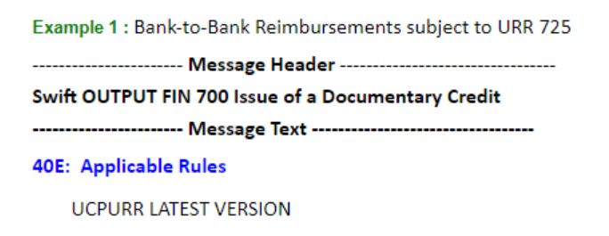
Reimbursement and Reimbursing Bank
Reimbursement is defined as a compensation paid to someone for an expense.
Reimbursing bank is the bank that, at the request of the issuing bank, is authorized to pay, or accept and pay time draft under a documentary credit in accordance with UCP 600 article 13 or if incorporated, the ICC uniform Rules for Bank-to-Bank Reimbursements under Documentary Credits (URR 725). (1)
There are two possible reasons that makes a reimbursing bank necessary under a documentary credit transaction.
First reason may be that the confirming bank does not trust the issuing bank in terms of risk issues and demands more security. In this situation presence of the reimbursing bank is a requirement for the confirmation.
Second reason could be that the issuing bank and nominated bank (in case confirmed letter of credit confirming bank) do not have an account relationship, as a result they may be requiring a third bank’s service for the settlement.
Rules Covering Bank-to-Bank Reimbursements Under Letters of Credit:
Reimbursements must be governed either by URR 725 or UCP 600 article 13 for the letters of credit which are opened according to latest documentary credit rules. If issuing bank would like to be the reimbursement is subject to URR 725, then it must make a reference at the swift message when issuing a letter of credit.

Slide 37
Reimbursement and Reimbursing Bank
Some important definitions from URR 725 – The Uniform Rules for Bank-to-Bank Reimbursements under Documentary Credits:
“Claiming bank” means a bank that honours or negotiates a credit and presents a reimbursement claim to the reimbursing bank. “Claiming bank” includes a bank authorized to present a reimbursement claim to the reimbursing bank on behalf of the bank that honours or negotiates.
“Issuing bank” means the bank that has issued a credit and the reimbursement authorization under that credit.
“Reimbursing bank” means the bank instructed or authorized to provide reimbursement pursuant to a reimbursement authorization issued by the issuing bank
“Reimbursement Authorization” means an instruction or authorization, independent of the credit, issued by an issuing bank to a reimbursing bank to reimburse a claiming bank or, if so requested by the issuing bank, to accept and pay a time draft drawn on the reimbursing bank.
“Reimbursement Undertaking” means a separate irrevocable undertaking of the reimbursing bank, issued upon the authorization or request of the issuing bank, to the claiming bank named in the reimbursement authorization, to honour that bank’s reimbursement claim, provided the terms and conditions of the reimbursement undertaking have been complied with.
“Reimbursement Claim” means a request for reimbursement from the claiming bank to the reimbursing bank.

Slide 38
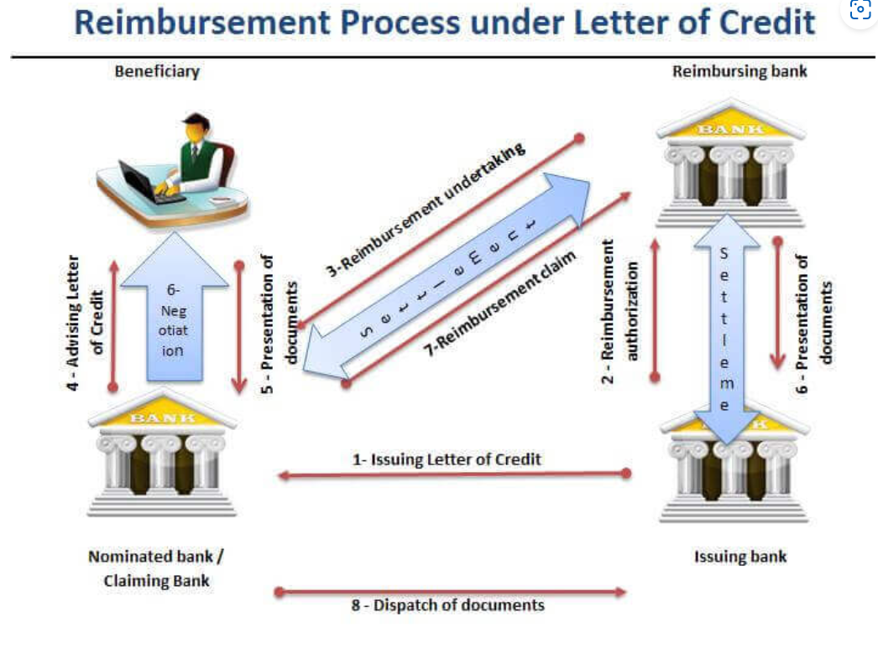
Reimbursement Process
Issuing bank issues the letter of credit and transmits it to the nominated bank via swift message.
Issuing bank gives reimbursement authorization to reimbursing bank.
Reimbursing bank issues its reimbursement undertaking and transmits it to the nominated bank via swift message.
Nominated bank advices the letter of credit to the beneficiary. (please keep in mind that step 3 and step 4 may be change their sequence)
Beneficiary presents documents to the nominated bank.
Nominated bank checks the documents and negotiate upon a complying presentation.
Nominated bank sends it reimbursement claim to the reimbursing bank. Reimbursing bank reimburse nominated bank according to terms and conditions of the reimbursement undertaking.
Nominated bank send documents to the issuing bank.
On the final stage issuing bank and reimbursing bank arrange settlement between themselves. Issuing bank gets the letter of credit amount from the applicant and releases original shipment documents.

Slide 39
Reimbursement Process
SWIFT message types and operating guidelines impose an additional discipline with respect to bank-to-bank reimbursements. Three message types apply – in particular:
MT740 (‘Authorisation to reimburse’);
MT747 (‘Amendment to an authorisation to reimburse’); and
MT742 (‘Reimbursement claim’).

Slide 40
Types of Documents
Transport Documents- These documents are issued by the shipping line, airline, international trucking company, railroad, freight forwarder or logistics company.
insurance documents –providing cover against risk to the goods during their carriage from the beneficiary’s premises / country of export to the country of import / applicant’s premises
commercial documents – identifying and describing the goods, as stipulated in the documentary credit
official documents – evidencing compliance with the requirements of the country of export or the country of import.
Financial Documents- draft (bill of exchange) that determines the amount to be drawn under the documentary credit by way of honour or negotiation.

Slide 41
Transport Documents
In international trade, the goods move from the warehouse of the exporter to the warehouse of the importer. The goods may move by land water or air or a combination of one or more of these modes.
Transport documents are issued by a shipping line, air cargo carrier, trucking company, or freight forwarder that detail the terms of transport for cargo.
Types of Transport Documents:
1. Multimodal transport documents
2. Bill of Lading (sea)
3. Air Transport documents
4. Road ,Rail, Inland waterbay

Slide 42
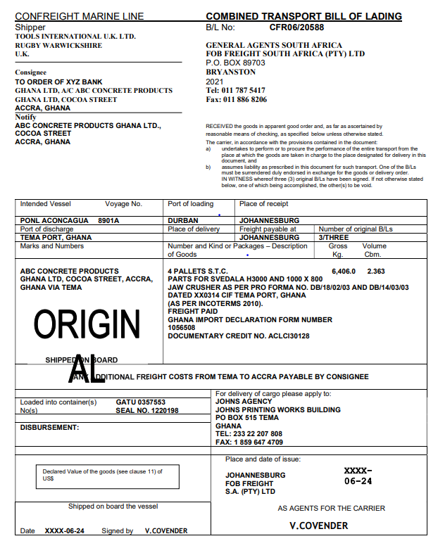
Multimodal transport documents
A multimodal transport document is a document that covers at least two different modes of transport.
If the carriage involves, for example, travel over land and then by sea, the transport document is usually titled a ‘combined’, ‘through’ or ‘multimodal’ transport document.
Under a documentary credit, an issuing bank will usually require a multimodal transport document to evidence that the goods are consigned to its order, or ‘to the order of the shipper’ (or ‘to order’), and to be endorsed by the shipper in blank or to order of the issuing bank.
If an issuing bank seeks to obtain security through the goods by means of a multimodal transport document, it should insist that all originals of the document are presented to it.
If a multimodal transport document is issued to order of a named entity, or ‘to order’, or ‘to order of shipper’, delivery of goods will be made against the surrender of an original multimodal transport document or against shipping guarantee (explained in later slides).

Slide 43
Bill of lading
This is a transport document, which represents the movement of goods by water.
A Bill of Lading is a formal receipt given by a ship owner or their authorized agents stating that the goods mentioned therein (quantity, quality, description etc.) are shipped on a specified date and vessel and are deliverable to the person mentioned therein or to his order after payment of all dues of the shipping company.
There are three main functions of a bill of lading
1. it is receipt for the goods
2. it is an evidence of contract
3. it is a document of title of goods
Types of bill of lading-
-Non- Negotiable
-Charter Party bill of lading

Slide 44
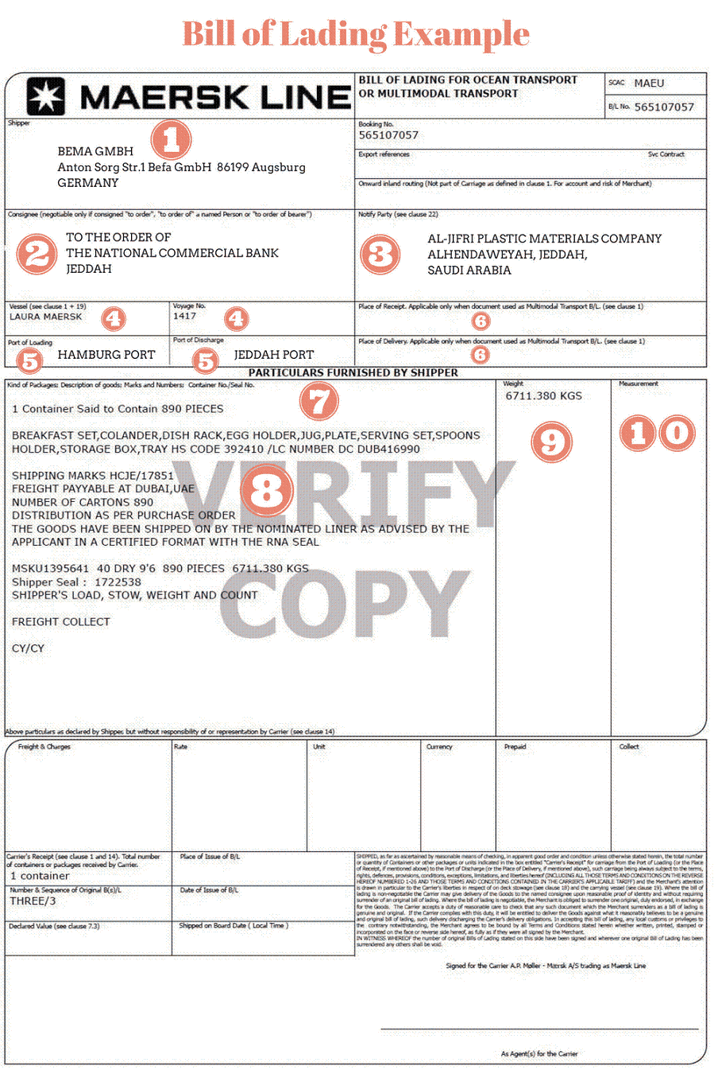
Sample Bill of Lading
Shipper: It is the party who owns the goods and hands over to the carrier. In most cases shipper is the exporter.
Consignee: It is the party, whom the goods will be delivered at the port of discharge/at the place of delivery.
Consignee field also determines whether the bill of lading is negotiable or not.
Most bills of lading have the following statement on their front face "This bill of lading is not negotiable unless marked (To Order) or (To Order of...) here.“
Notify: In some occasions, consignee field of the bill of lading does not disclose enough information regarding the receiver of the goods. In most cases, importer's contractual logistics operator's name and contact details are written on the notify field.
Notify party have no effect on title of goods.

Slide 45
Sample Bill of Lading
Port of loading/Port of discharge: Firstly, port of loading states where the carriage starts, and port of discharge shows where the carriage ends in port to port shipments. Secondly, port of loading and port of discharge defines carrier's responsibility period for port-to-port shipments.
Description of Packages and Goods: Bills of lading should state general description of goods, package types and package amount under "Description of Packages and Goods" field.

Slide 46
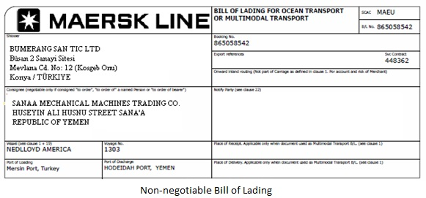
Non-negotiable sea waybills
Bill of Lading that cannot be transferred by endorsement is called a Non-Negotiable Bill of Lading. A negotiable bill of lading instructs the carrier to deliver goods to anyone in possession of the original endorsed negotiable bill, which itself represents title to and control of the goods.
Non-Negotiable Bill of Lading is also known as Straight Bill of Lading.

Slide 47
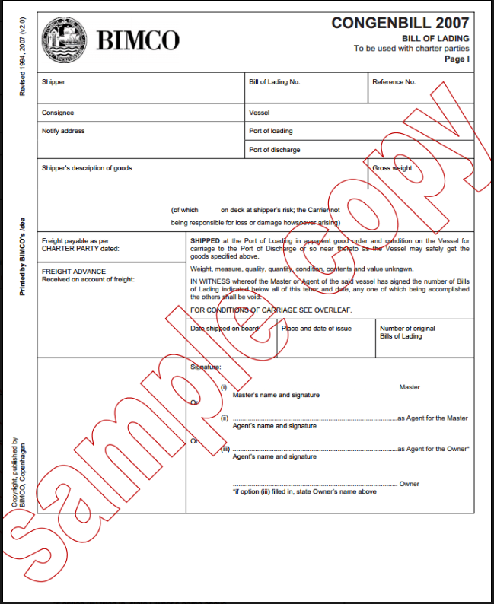
Charter party bills of lading
Unlike container transportation, bulk cargo shipment requires special types of vessels and is not suitable for liner services.
As a result, bulk cargo transportation is carried out via hired vessels. In maritime glossary, hiring a vessel is called “Charter Party”.
Charter Party Bill of Lading is the transport document of the shipments, which made via vessels subject to charter party contracts.
As per UCP 600 Article 22 :
-be signed by: - the master or a named agent for or on behalf of the master, or - the owner or a named agent for or on behalf of the owner, or - the charterer or a named agent for or on behalf of the charterer.
-indicate that the goods have been shipped on board a named vessel at the port of loading stated in the credit
-indicate shipment from the port of loading to the port of discharge stated in the credit. The port of discharge may also be shown as a range of ports or a geographical area, as stated in the credit.
be the sole original charter party bill of lading or, if issued in more than one original, be the full set as indicated on the charter party bill of lading.

Slide 48
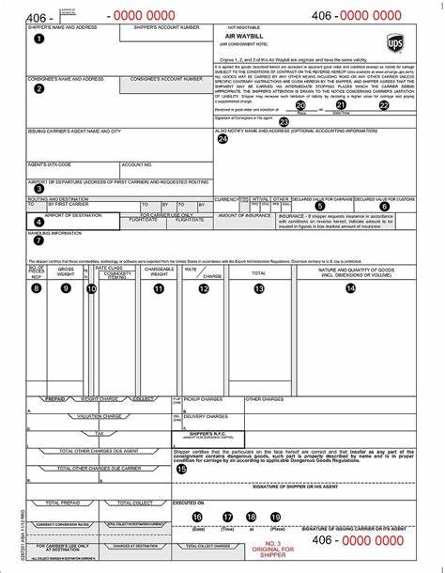
Air Transport Documents
The transport of goods by air gives rise to the issuance of an air transport document, more commonly known as an ‘air waybill’ or ‘air consignment note’.
An air transport document is not a document of title and is not a negotiable document.
Control over goods rests with the shipper as consignor and the carrier up to the point of delivery.
If an issuing bank wishes to exercise control over the goods, it should insist on being named as the consignee.
The carrier will deliver goods to the consignee, as shown on the air transport document, against proper identification, or against a delivery order or release note from the named consignee.

Slide 49
Road, rail or inland waterway transport documents
Transport documents covering the dispatch of goods by rail or by road are known as ‘rail consignment notes’ or ‘road consignment notes’, respectively
Road consignment notes are also referred to as ‘truck waybills’, ‘truck consignment notes’.
These are not documents of title and are not negotiable documents. The exception is when an inland waterway transport document is issued in the form of a bill of lading – that is, to order of a named entity, or ‘to order’ or ‘to order of the shipper’.

Slide 50
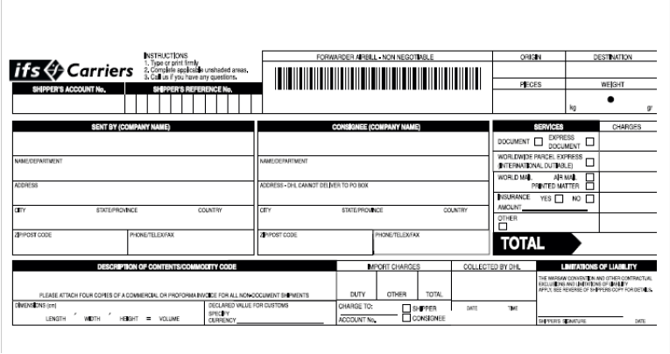
Courier receipts, post receipts or certificates of posting
A courier receipt, post receipt or certificate of posting serves as evidence that the goods have been received by a courier service or post office for delivery and show the name and address of the consignee.
These are not documents of title and are not negotiable documents.

Slide 51
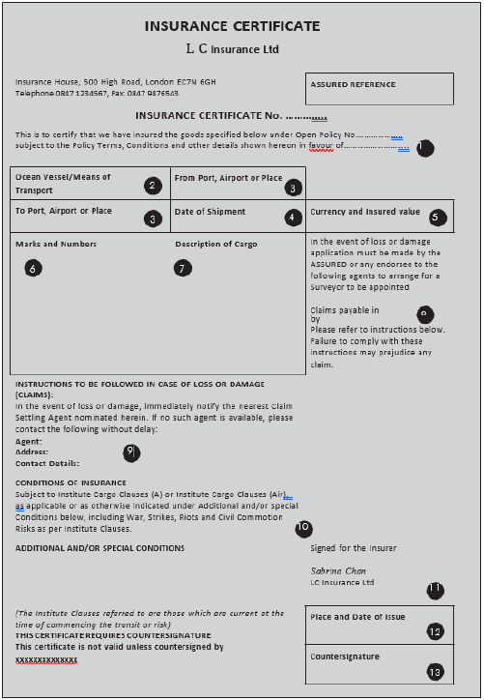
Insurance Documents
An insurance document, such as an insurance policy, an insurance certificate or a declaration under an open cover, must appear to be issued and signed by an insurance company.
The decision as to whether the beneficiary or applicant pays for and arranges the insurance of goods depends upon several factors
the sale contract evidences that goods are sold either on a ‘cost, insurance and freight’ (CIF) basis or on a ‘carriage and insurance paid to’ (CIP) basis, an insurance document should be shown as a required document in the documentary credit.
-

Slide 52
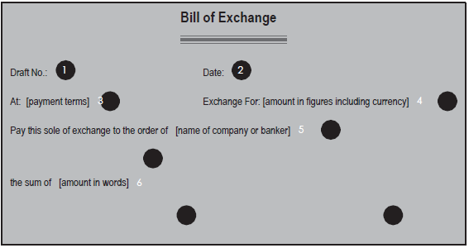
Financial Documents
Financial documents are legal documents that provide evidence of claims for amounts owed, such as a draft (bill of exchange) and promissory notes.

Slide 53
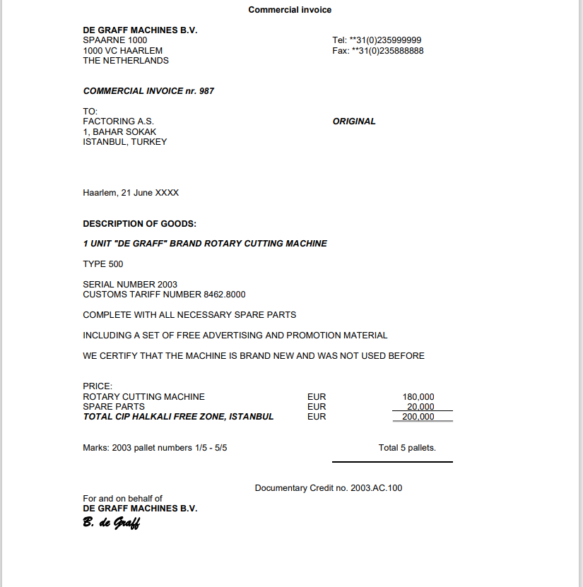
Commercial Documents
Commercial documents include invoices, certificates (of weight, inspection and of analysis, etc), and packing and weight lists.

Slide 54
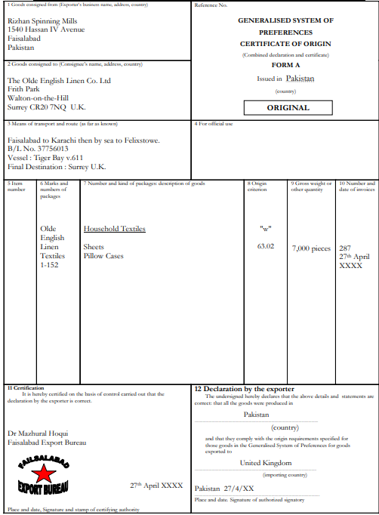
Official Documents
Official documents allow a party to the sale contract to satisfy regulatory requirements.
An applicant may need an official document to satisfy import regulations or health regulations.
Example: certificate of origin issued by a Chamber of Commerce.

Slide 55
INCOTERMS
INCOTEMRS 2022
INCOTERMS 2010 (INTERNATIONAL COMMERCIAL TERMS)
The purpose of Incoterms is to provide a set of standard and uniform international rules for the interpretation of most used trade terms in foreign trade.
These are official trade shipping terms agreed by the International Chamber of Commerce, Paris.
There are 11 Inco Terms and comes into force on 01st January 2011 .
Each Inco Term defines the responsibilities of buyers and sellers for the delivery of goods under sales contract.
They are authoritative rules for determining how costs and risks are allocated to the parties.

Slide 56
RULES FOR ANY MODE OF TRANSPORT: (AIR, ROAD, RAIL AND MULTIMODAL MODES)
EXW Ex Works
FCA Free Carrier
CPT Carriage Paid To
CIP Carriage and Insurance Paid To
DAT Delivered at Terminal
DAP Delivered at Place
DDP Delivery Duty Paid
RULES FOR SEA AND INLAND WATERWAY TRANSPORT
FAS Free Alongside Ship
FOB Free on Board
CFR Cost & Freight
CIF Cost, Insurance & Freight

Slide 57
The first class includes the seven Incoterms 2010 rules that can be used irrespective of the mode of transport selected and irrespective of whether one or more than one mode of transport is employed. They can be used even where there is no maritime transport at all.
It is important to remember, however, that these rules can be used in cases where a ship is used for part of the carriage. In the second class of Incoterms 2010 rules, the point of delivery and the place to which the goods are carried to the buyer are both ports.

Slide 58
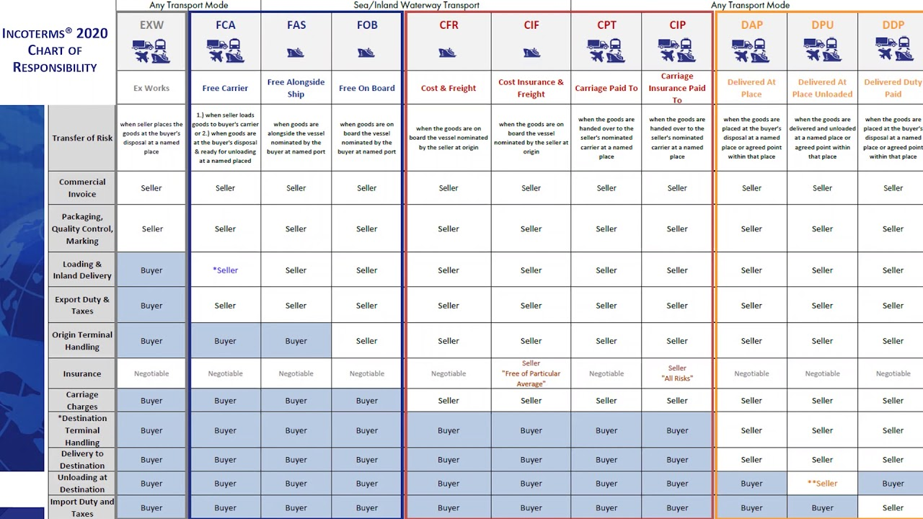

Slide 59
UCP 600 - Uniform Customs and Practice for Documentary Credits
UCP 600 are the latest revision of the Uniform Customs and Practice that govern the operation of letters of credit.
UCP 600 comes into effect on 01 July 2007 The 39 articles of UCP 600 are a comprehensive and practical working aid to bankers, lawyers, importers, and exporters, transport executives, educators, and everyone involved in letter of credit transactions worldwide.
“The Uniform Customs and Practice for Documentary Credits, 2007 Revision, ICC Publication no. 600 ("UCP") are rules that apply to any documentary credit ("credit") (including, to the extent to which they may be applicable, any standby letter of credit) when the text of the credit expressly indicates that it is subject to these rules. They are binding on all parties thereto unless expressly modified or excluded by the credit.”

Slide 60
Summary of the Key Articles in the ICC UCP 600
Here are a few of the key elements which make up the UCP 600:
Definition of key terms which are prevalent in international trade (e.g. honouring [of payments], applicants, banking days, presentation)
How international trade documents (Letters of Credit) can be signed and acknowledged by all parties
The difference between documents, goods and services (and which parties deal with these)
Which parts of a Letter of Credit are negotiable and non-negotiable
How credit works, and how payment is made
How banks can communicate the confirmation of goods (teletransmission)
Transportation of the goods, modes of transport, and who bears responsibility
How to deal with discrepancies, waivers and giving notice
The provision of original documents or electronic copies
Bills of Lading
Insurance and covering the cost of goods
Loss of shipping documents in transit

Slide 61
Summary of the Key Articles in the ICC UCP 600
Articles 1 – 5 – General Provisions and Definitions
Articles 6 – 13 – Liabilities and Responsibilities
Articles 14 – Examination of Documents
Article 15 – 17 – Examination of Documents
Articles 18 – 28 – Documents
Articles 29 – 33 – Miscellaneous Provisions
Articles 34 – 37 – Disclaimers
Articles 38 – 39 – Transferable Credit & Assignment

Slide 62
eUCP 2.0 Articles:
eUCP supplement for Electronic Presentations first published in 2002 as version 1.0 supplemented UCP 500, later updated as version 1.1 in 2007 to accompany the publication of UCP 600 and to bring it in line with the changes in terminology in UCP 600 and recently as version 2.0 in 2019 in order to accommodate current practice, technological developments and the continuing evolution toward electronic presentation.
e1 Scope of the Uniform Customs and Practice for Documentary Credits (UCP 600) Supplement for Electronic Presentations (“eUCP”)
e2 Relationship of the eUCP to the UCP
e3 Definitions
e4 Electronic Records and Paper Documents V. Goods, Services or Performance (new article)
e5 Format
e6 Presentation
e7 Examination

Slide 63
eUCP 2.0 Articles: CONT.
e8 Notice of Refusal
e9 Originals and Copies
e10 Date of Issuance
e11 Transport
e12 Data Corruption of an Electronic Record
e13 Additional Disclaimer of Liability for Presentation of Electronic Records under eUCP
e14 Force Majeure (new article)

Slide 64
ISP98 – International Standby Practices
International Standby Practices (ISP98) An international set of rules governing the rights and obligations of parties under standby letters of credit produced by the International Chamber of Commerce. The current version is ISP98, ICC Publication No 590.
It reflects generally accepted practice, custom, and usage of standby letters of credit.
It provides separate rules for standby letters of credit in the same sense that the Uniform Customs and Practice for Documentary Credits (UCP) and the Uniform Rules for Demand Guarantees (URDG) do for commercial letters of credit and independent bank guarantees.

Slide 65
URR 725 – Uniform Rules for bank-to-bank reimbursement under documentary
The URR 725 are the Uniform Rules for Bank-to-Bank Reimbursements under Documentary Credits ICC publication No. 725. URR 725 was approved by the ICC national committees at the ICC Banking Commission in April 2008. URR 725 has been effective since 01 October 2008.

Slide 66
URR 725 Articles
1. Application of URR
2. Definitions
3. Reimbursement Authorizations Versus Credits
4. Honour of a Reimbursement Claim
5. Responsibility of the Issuing Bank
6. Issuance and Receipt of a Reimbursement Authorization or Reimbursement Amendment
7. Expiry of a Reimbursement Authorization
8. Amendment or Cancellation of a Reimbursement Authorization
9. Reimbursement Undertaking
10. Standards for a Reimbursement Claim
11. Processing a Reimbursement Claim
12. Duplication of a Reimbursement Authorization
13. Foreign Laws and Usages
14. Disclaimer on the Transmission of Messages
15. Force Majeure
16. Charges
17. Interest Claims/Loss of Value

Slide 67
ISBP 745
“The International Standard Banking Practice (ISBP) is a publication of the International Chamber of Commerce (ICC). It offers crucial guidance on the documents presented against letters of credit. Take note that ISBP does not change UCP 600 rules when it comes to letters of credit. However, it is a valuable guide to Uniform Customs and Practice (UCP).”

Slide 68
Key Sections of ISBP 745
A) GENERAL PRINCIPLES
B) DRAFTS AND CALCULATION OF MATURITY DATE
C) INVOICES
D) TRANSPORT DOCUMENT COVERING AT LEAST TWO DIFFERENT MODES OF TRANSPORT (“MULTIMODAL OR COMBINED
TRANSPORT DOCUMENT”
E) BILL OF LADING
F) NON-NEGOTIABLE SEA WAYBILL
G) CHARTER PARTY BILL OF LADING
H) AIR TRANSPORT DOCUMENT
J) ROAD, RAIL OR INLAND WATERWAY TRANSPORT DOCUMENTS
K) INSURANCE DOCUMENT AND COVERAGE
L) CERTIFICATE OF ORIGIN
M) PACKING LIST, NOTE OR SLIP (“PACKING LIST”)
N) WEIGHT LIST, NOTE OR SLIP (“WEIGHT LIST”)
P) BENEFICIARY’S CERTIFICATE
Q) ANALYSIS, INSPECTION, HEALTH, PHYTOSANITARY, QUANTITY, QUALITY AND OTHER CERTIFICATES (“CERTIFICATE”)

Slide 69
The processes and challenges involved in documentary credit transactions:

Slide 70
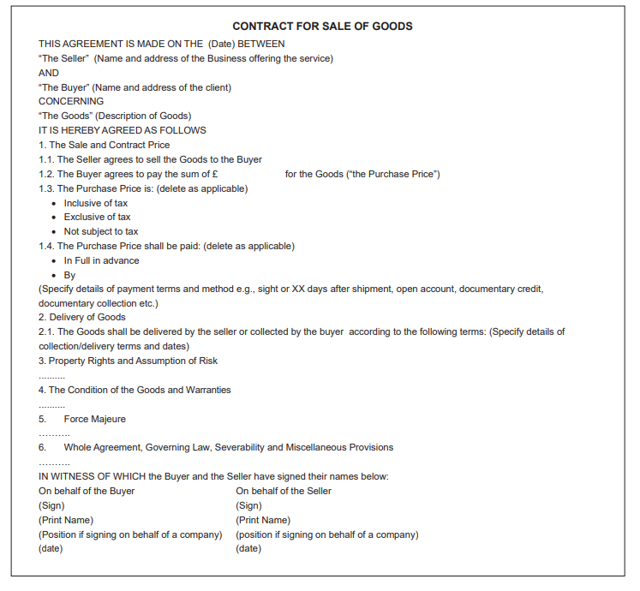
Sales Contract/Contract of Sale
The most basic agreement in international trade is the sale contract concluded between a seller and a buyer. This is often referred to as a ‘sale agreement’, an ‘export contract’ or a ‘foreign sale agreement’.
Having agreed that the method of settlement is to be a documentary credit, it is important that the sale contract be as specific as possible in describing the payment terms and the type of documentary credit that is required.
Sale contract is governed, at least in part, by the laws of the country in which one of the parties involved is located.
The sale contract is an act that is outside the documentary credit and the UCP 600.

Slide 71
Sales Contract/Contract of Sale
One of the challenges in any sale contract is to ensure that both parties understand their responsibilities includes payment of carriage, insurance, loading and unloading costs, import and export taxes, and any other associated costs.
The chance of dispute is minimised when the parties share the same understanding of their respective responsibilities.
One of the best ways in which to minimise the chance of a dispute, in both domestic and international trade, is to use Incoterms .
Incoterms deal solely with the rights and responsibilities of parties involved in the delivery of goods sold under a sale contract.
For example, the Incoterm CFR (‘cost and freight’) implies that carriage will be effected on a port-to-port basis. This means that either a bill of lading, a charter party bill of lading or a non-negotiable sea waybill should be requested. Under a documentary credit, the type of transport document called for should comply with the stated Incoterm.
Sub-article 4(a) - it is the responsibility of the applicant to ensure that its documentary credit application form reflects the terms and conditions of the sale contract, as agreed with the beneficiary

Slide 72
LC Issuance
The prerequisites for the issuance of a documentary credit :
The need for a credit facility : Bank obtain security that have a monetary value and can be used in the event of default by the applicant.
Completion of know your customer (KYC) and customer due diligence (CDD) formalities :
A bank’s KYC procedures should include a process whereby it is able to obtain sufficient evidence of a prospective client’s identity.
A bank’s CDD measures require the ongoing review of a client’s business profile. For example a company originally imported household electrical equipment and has now started importing pipe and engineering materials.
In addition to KYC and CDD formalities, a bank should also assess transactions from a potential money laundering, terrorist financing and sanctions perspective.
Applying for the issuance of a documentary credit :
It is a buyer’s responsibility to request the issuance of a documentary credit.
when completing the application form, an applicant should:
provide its bank with clear and precise instructions, avoiding any form of ambiguity in describing the terms and conditions that are to be complied with by the beneficiary;
maintain an awareness of the documents that are necessary for the import of the concerned goods
ensure that all terms and conditions, and the documents called for, are in accordance with the sale contract or proforma invoice agreed with the beneficiary.
Provide details of type , is settlement due on usance or sight , currency ,amount of LC , validity date, last date of shipment ,period of presentation, incoterm, is it to be confirmed or not.
Delivery of the completed documentary credit application form to the issuing bank :
The application form, when completed and either approved online or signed by the applicant, acts as a request to its bank (known as the ‘issuing bank’) to issue an irrevocable documentary credit in favour of the named beneficiary. The application will be submitted to the bank in either electronic or hard copy.

Slide 73
Documents Checking – Issuance of LC
Receipt of the completed documentary credit application form :ISBP 745 places a responsibility on a customer (applicant) to provide clear instructions to issue or amend a documentary credit and to understand the impact of certain provisions of UCP 600.
Reviewing the documentary credit application form against an agreed credit facility :It is expected that prior to a customer completing a documentary credit application form it will already have an agreed credit facility in place. A facility will establish the maximum value of documentary credits that may be outstanding at any one time.
Reviewing a documentary credit application form against bank policy and regulatory requirements
-Types of settlement : Sub-article 6(b) requires that a documentary credit state whether it is available by sight payment, deferred payment, acceptance or negotiation.
-Negotiation : Documentary credits available by negotiation provide a means by which the beneficiary may be able to obtain finance by requesting the nominated bank to negotiate – that is, to provide an advance of the proceeds earlier than the date that settlement or reimbursement is due from the issuing bank, or to agree to effect settlement on such date.
-The place and date of expiry
-Applicant and beneficiary details
-Documentary credit amount and tolerance, if any
-Partial shipments and transhipment
-Shipment routing and latest shipment date or period
-Goods description
-Documents required
-Period for presentation
-Confirmation instructions

Slide 74
Selecting an advising bank and / or a confirming bank :
Wherever possible, banks use their own branches, associate offices or preferred correspondent banks to advise a documentary credit to a beneficiary. The reasons are that:
• arrangements already exist for authentication of messages; and
• the lines of communication are well established, which enables the speedy resolution of any problems that may arise.
An application form will usually include the name and location of an advising bank.
If the chosen bank of the beneficiary is not a correspondent of the issuing bank, the credit may still be routed through that bank by means of the advising bank sending it to that bank. The bank of the beneficiary will be known as a ‘second advising bank’.
It can be that a beneficiary will require the confirmation of the credit by a bank local to it. Like an advising bank, the issuing bank must be in a correspondent banking relationship with a bank that will be requested or authorised to add confirmation and have a credit facility in place to allow that confirmation to occur.
Notes:
UCP 600 - Article 7

Slide 75
Preparing a documentary credit :
In addition to the details supplied by the customer, the issuing bank will include reimbursement instructions and any other bank-to-bank information, such as how documents are to be forwarded and whether the advising bank or another bank is requested or authorised to add its confirmation before sending the documentary credit to the beneficiary.
The application for issuance and the actual documentary credit, as issued, must match and be in accordance with the instructions of the customer.
Notes:
The applicant should be encouraged to read the documentary credit carefully, to ensure that it matches its instructions. If it does not, the applicant should advise the issuing bank without delay.

Slide 76
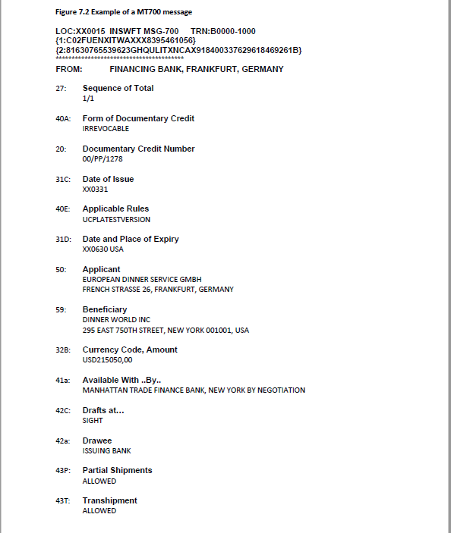
Transmitting a documentary credit :
Once the documentary credit is prepared and the issuing bank’s internal release procedures are completed, the credit will be transmitted by SWIFT.
Documentary credits are issued in SWIFT MT700 format.
An issuing bank will generally send an amendment using a SWIFT MT7 type message, such as an MT707 or MT799.
MT700 is the SWIFT message type generally used to convey the details of a documentary credit to an advising bank, with or without a request or authorisation for confirmation to be added.
Article 1 requires that the text of a documentary credit make express reference to the rules to which it is subject. To accommodate this, SWIFT has created the following code words to be used in Field 40E of the MT700 message series by the issuing bank.
• For UCP 600: ‘UCPLATESTVERSION’
• For eUCP: ‘EUCPLATESTVERSION’
• For UCP 600 and URR 725: ‘UCPURRLATESTVERSION’
• For eUCP and URR 725: ‘EUCPURRLATESTVERSION’

Slide 77
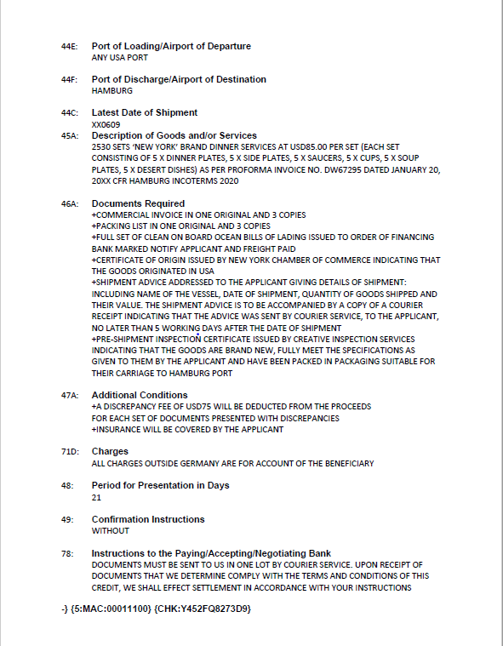

Slide 78
Challenges Faced by Issuing bank
Issuing a letter of credit (LC) involves a complex process, and banks face several challenges during the issuance. Some of the challenges faced by banks while issuing LCs are:
Compliance: Banks must ensure that they comply with all the regulatory requirements and guidelines for issuing LCs. Non-compliance can lead to fines and penalties.
Fraud: LCs are vulnerable to fraud, and banks must take measures to prevent fraud. Banks need to verify the authenticity of the LC application, the identity of the parties involved, and the documents presented.
Discrepancies: The documents presented under the LC must conform to the terms and conditions of the LC. Banks must carefully scrutinize the documents to ensure that they comply with the LC terms. Any discrepancies can delay or even prevent payment to the beneficiary.
Time-sensitive nature: LCs are time-sensitive, and banks must process the application within a stipulated time frame. Any delay can impact the transaction and cause financial losses to the parties involved.
Communication: Banks must communicate effectively with the parties involved in the LC transaction. Miscommunication can lead to misunderstandings and delays in the transaction.
Technical issues: Banks need to use technology to process LCs efficiently. However, technical issues such as system downtime or software errors can cause delays in the process.
Political risks: In some cases, political risks may arise, such as changes in government policies or regulations. Banks must take these risks into account while issuing LCs.

Slide 79
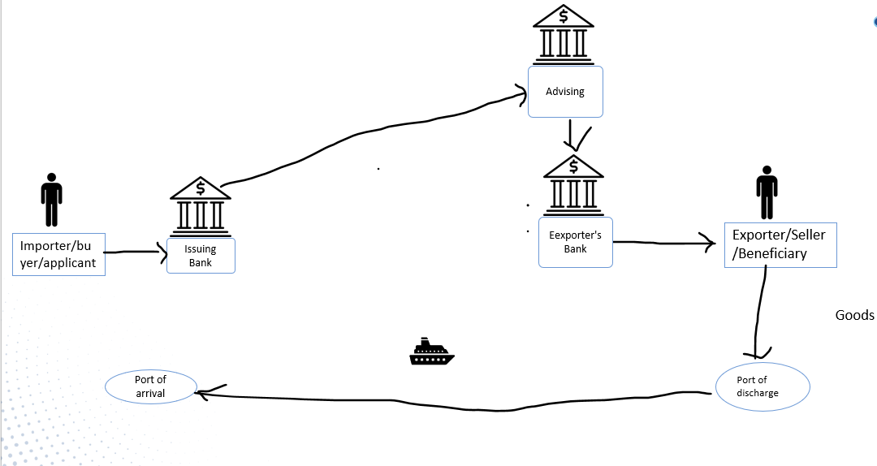
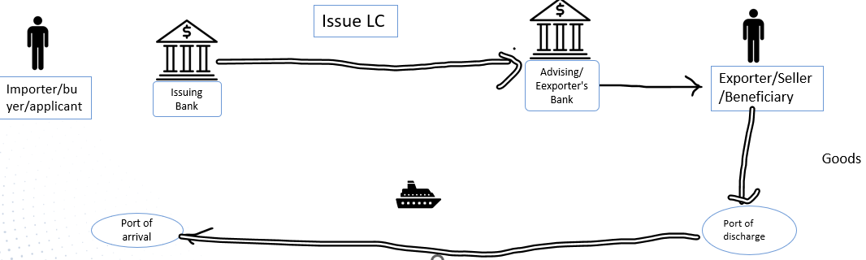
LC Advising
A credit and any amendment may be advised to a beneficiary through an advising bank. An advising bank that is not a confirming bank advises the credit and any amendment without any undertaking to honour or negotiate.
By advising the credit or amendment, the advising bank signifies that it has satisfied itself as to the apparent authenticity of the credit or amendment and that the advice accurately reflects the terms and conditions of the credit or amendment received.
An advising bank may utilize the services of another bank ("second advising bank") to advise the credit and any amendment to the beneficiary. By advising the credit or amendment, the second advising bank signifies that it has satisfied itself as to the apparent authenticity of the advice it has received and that the advice accurately reflects the terms and conditions of the credit or amendment received.
A bank utilizing the services of an advising bank or second advising bank to advise a credit must use the same bank to advise any amendment thereto.
If a bank is requested to advise a credit or amendment but elects not to do so, it must so inform, without delay, the bank from which the credit, amendment or advice has been received.
One of the first items to be reviewed will be whether there is an authorisation or request for confirmation to be added. If the answer is ‘yes’, this will change the form of advice and the process that needs to be followed. (Confirmation explained next topic)
An advising or second advising bank will usually maintain a standard form of advice that it uses to advise a documentary credit to a beneficiary. These will vary in substance from bank to bank.
It should be noted that in its advice of the documentary credit an advising or second advising bank is not required to translate any of its text or interpret any technical terms.(Article 35)
In most cases, the advising or second advising bank will advise the details of the documentary credit in letter form. This letter will either be sent to the beneficiary by mail or by courier, or the beneficiary will collect it from the offices of the bank.
Notes:
UCP Article 9

Slide 80
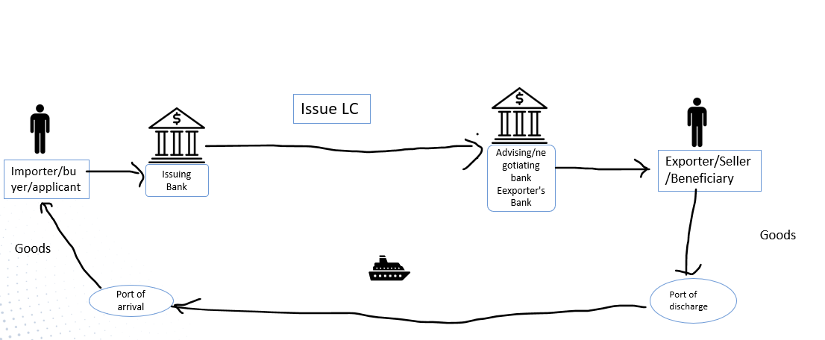
The Role of The Nominated Bank
Nominated Bank means the bank with which the letter of credit is available or any bank in the case of a credit available with any bank.
According to the letter of credit rules a letter of credit must state the bank with which it is available.
Alternatively, it is possible to open a letter of credit to be available with any bank. These kinds of letters of credit are known as “freely negotiable letters of credit”.
For a documentary credit issued using a SWIFT MT700 message, this will be indicated in field 41a ‘Available With … By … ’. This field will indicate the name of the bank with which it is to be available or state ‘Any Bank’ or ‘Available with Any Bank’.
UCP 600 defines the responsibilities of a nominated bank in two main categories:
Payment Responsibility-
Acceptance of Presentation Responsibility

Slide 81
The Role of The Nominated Bank
Payment Responsibility:
Provided that the stipulated documents are presented to the nominated bank and that they constitute a complying presentation, the nominated bank should honor if the credit is available by sight payment, deferred payment or acceptance with a nominated bank.
Alternatively, the nominated bank can negotiate the complying presentation if letter of credit is available by negotiation with the nominated bank.
But it is worth mentioning that unless a nominated bank is the confirming bank, an authorization to honor or negotiate does not impose any obligation on that nominated bank to honor or negotiate, except when expressly agreed to by that nominated bank and so communicated to the beneficiary.
In daily practice, nominated banks rarely pay to the beneficiaries against the complying presentation. What they commonly do is just to receive the documents from the beneficiaries and send them to the issuing banks by demanding reimbursement either from the issuing bank or reimbursing bank.
Nominated bank transfer the letter of credit amount, which they have received from one of these two banks to the beneficiaries.

Slide 82
The Role of The Nominated Bank
Acceptance of Presentation Responsibility:
If a letter of credit is available with a nominated bank, then the authorized nominated bank should accept the presentation of the beneficiary.
The acceptance of presentation does not give any payment obligation to the nominated bank.
By presenting documents to a bank in their own country, beneficiaries could complete their presentations faster. This is one of the biggest advantages of using a nominated bank for the beneficiaries.

Slide 83
The Role of The Nominated Bank
Nominated bank acting on its nomination :
If a bank agrees to act as nominated bank, it should:
• examine all documents received in terms of sub-article 14(a), and other related articles; and
• handle discrepant documents in terms of article 16, and other related articles.
Upon effecting honour or negotiation, a nominated bank is required to dispatch the documents to the issuing bank (or confirming bank) according to the instructions stated in the documentary credit (sub-article 15(c)).
Reimbursement that is due to a nominated bank for any honour or negotiation made to a beneficiary is effected in accordance with the reimbursement condition that should be specified in the documentary credit. This may, for example, allow for the nominated bank:
to debit an account of the issuing bank that is held with it;
to claim reimbursement from another bank (a reimbursing bank) or to claim from a funding institution such as the World Bank;
to be reimbursed by the issuing bank when the issuing bank determines that the documents represent a complying presentation; or
to claim reimbursement from the issuing bank by SWIFT message when it determines that the documents represent a complying presentation.

Slide 84
The Role of The Nominated Bank
Nominated bank not acting on its nomination :
When a bank is nominated in the documentary credit to honour or negotiate and it decides not to do so, or the beneficiary does not request the bank to honour or negotiate, the bank acts in no greater capacity than the beneficiary in presenting the documents to the issuing bank.
The fact that a nominated bank does not act on its nomination at the time of determining that the documents comply does not stop that bank from honouring or negotiating at any future time, up to and including the date on which payment is due to the beneficiary and reimbursement is expected from the issuing bank.
For example, a number of banks will honour or negotiate only when they receive an advice from the issuing bank that the documents have been found to be compliant.

Slide 85
Presentation
In order to receive settlement, the beneficiary is required to prepare and present (or arrange the presentation of) a set of documents that complies with the terms and conditions of the documentary credit.
When documents have been presented, there are a number of key points that will be considered by a document examiner. These are as follows.
-Have all documents been presented to the correct location?
-Have all the documents been presented on, or before, the expiry date of the documentary credit?
-Have all documents been presented no later than the stated presentation period?
Examining the documents :A document examiner should examine the documents systematically, following a procedure that includes:
• examination of the documents with reference to the documentary credit, including accepted amendments;
• examination of the documents with reference to the applicable articles of UCP 600; and
• examination of the documents with reference to one another.

Slide 86
Examining the documents against the documentary credit
If the documentary credit is sent by SWIFT MT700 or MT710 message, it will be in a structured format, with fields designated for each type of data content.
1. Form of documentary credit (40A) – a mandatory field : The type and characteristics of the documentary credit – that is, whether it is IRREVOCABLE, IRREVOCABLE TRANSFERABLE, IRREVOCABLE STANDBY or IRREVOC TRANS STANDBY (ie Irrevocable Transferable Standby) – is indicated here. While UCP 600 does not specifically recognise revocable documentary credits, such credits may be issued subject to UCP 600. In this event, the terms and conditions relating to the revocability of the documentary credit must be incorporated into its terms and conditions.
2. Documentary credit number (20) – a mandatory field :This is the number assigned to the documentary credit by the issuing bank.
3. Date of issue (31C) – a mandatory field :Is there a stipulation in the documentary credit indicating that one (or more) of the documents dated prior to the issue date is (are) not acceptable? A document examiner should refer to sub-article 14(i) in respect of the dating of documents.
4.Applicable rules (40E) – a mandatory field :The rules that are applicable to the documentary credit must be specified here. Depending on whether UCP 600, ISP98, or eUCP, and URR are applicable, this will read ‘UCP LATEST VERSION’, ‘EUCP LATEST VERSION’, ‘UCPURR LATEST VERSION’, ‘EUCPURR LATEST VERSION’, ‘ISP LATEST VERSION’

Slide 87
Examining the documents against the documentary credit
5. Date and place of expiry (31D) – a mandatory field - Date of expiry – presentation must be made on or before the date stipulated other than as provided for in sub-article 29(a).
6. Applicant (50) – a mandatory field - This will be the name of the entity on whose behalf the documentary credit has been issued.
7. Beneficiary (59) – a mandatory field - This will be the name of the party in whose favour the documentary credit has been issued.
8. Currency code, amount (32B) – a mandatory field
Percentage credit amount tolerance (39A) – an optional field
Maximum credit amount (39B) – an optional field – and/or
Additional amounts covered (39C) – an optional field
9. Available with … by … (41a) – a mandatory field - This field identifies the bank authorised to pay, accept a draft, incur a deferred payment undertaking (ie to honour) or negotiate.
10. Drafts at (42C) – an optional field
Drawee (42a) – an optional field

Slide 88
Examining the documents against the documentary credit
11. Mixed payment details (42M) – an optional field
Occasionally, a documentary credit will be available for settlement not just at sight or at a future determinable date, but by a mixture of both or a mixture of future determinable dates.
12. Negotiation/deferred payment details (42P) – an optional field
13. Partial shipments (43P) – an optional field
14. Transhipment (43T) – an optional field - A document examiner must examine the transport document against the transhipment rule that appears in the applicable transport article in UCP 600.
15. Place of taking in charge/Dispatch from ... /Place of Receipt (44A) – an optional field
Port of loading/Airport of departure (44E) – an optional field
Port of discharge/Airport of Destination (44F) – an optional field – and/or
Place of Final Destination/For transportation to ... /Place of Delivery (44B) – an optional field
16. Latest date of shipment (44C) – an optional field
17. Shipment period (44D) – an optional field
18. Description of goods and/or services (45A) – an optional field

Slide 89
Examining the documents against the documentary credit
19. Documents required (46A) – an optional field
This field describes the documentary requirements. A document examiner must:
• read the requirements in this field in relation to all documents; and
• read any requirements elsewhere in the documentary credit that may relate to one or more of the stipulated documents, ie in field 47A (Additional Conditions).
20. Additional conditions (47A) – an optional field
21. Special payment conditions for the beneficiary (49G) – an optional field
Special payment conditions for receiving bank (49H) – an optional field
If completed in the MT700 message, these fields should be reviewed and complied with to the extent that the content does not conflict with any other instructions or conditions that have been agreed. Any conflict should be resolved before any payment is made.
22. Charges (71D) – an optional field
23. Period for presentation in days (48) – an optional field - document examiner’s attention is drawn to sub-article 14(c) for the default period of 21 calendar days when no presentation period is specified.

Slide 90
Examining the documents against the documentary credit
24. Confirmation instructions (49) – a mandatory field : document examiner must ascertain whether there was a request or authorisation for confirmation to be added and what was the name of the confirming bank, if other than his or her bank, along with whether confirmation has been added, and if so, whether confirmation has been extended to all amendments, if any (article 8 and sub-article 10(b)).
25. Reimbursing bank (53a) – an optional field
26. Instructions to the paying/accepting/negotiating bank (78) – an optional field - This field will provide the document examiner with information as to where and by which method the documents are to be sent to the issuing bank (MT700) or the confirming bank or other nominated bank (MT710).

Slide 91
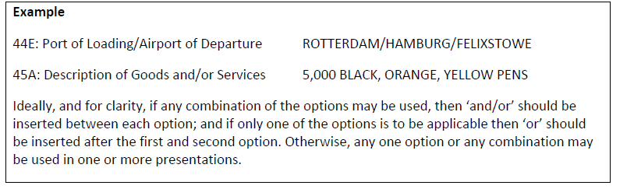
The standards for examination of documents under article 14 and ISBP 745
UCP 600 Article 14:
Sub-article 14(c) indicates that if no time limit is stipulated in the documentary credit, a period of 21 calendar days after the date of shipment is allowed for the presentation of documents that contain an original transport document. Such presentation must, in any event, be made no later than the expiry date of the documentary credit. (applies only to a documentary credit that requires presentation of an original transport document. )
The content of sub-article 14(e), relating to the description of the goods that may appear on documents other than the commercial invoice.
The content of sub-article 14(l), relating to the issuer of a transport document.
International standard banking practice (ISBP 745):
Paragraphs A1 and A2 consider abbreviations and the use of virgules (ie slash ‘/’ marks) or commas.

Slide 92
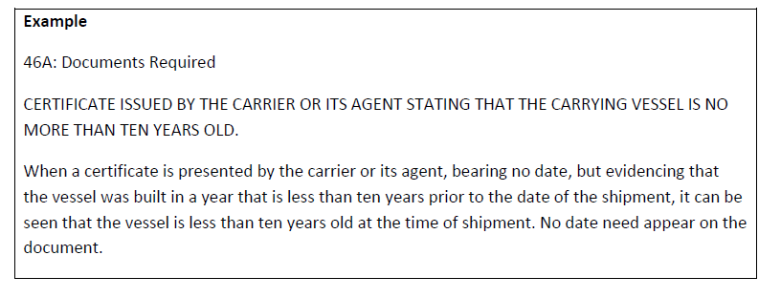
The standards for examination of documents under article 14 and ISBP 745
Paragraphs A3–A5 relate to certificates, certifications, declarations and statements.
Paragraphs A7–A9 explain the prevailing practice should any documents contain corrections or alterations.
Paragraphs A11–A16 relate to dates.
Paragraph A17 explains that although a document may have a box, field or space in which data is to be inserted, it need not be completed.
Paragraph A18 refers to a transport document other than those mentioned in articles 19–25, and the examination requirements for those documents, including the determination of a presentation period.
Paragraph A19 covers words and expressions that should not be used in documentary credits, but which in practice are still seen by a document examiner. There is no definition of their meaning in UCP 600.
Paragraph A20 describes the practice for identifying that a document has been issued by the entity named in a documentary credit.

Slide 93
The standards for examination of documents under article 14 and ISBP 745
Paragraph A21 provides guidance regarding the language in which documents are issued.
Paragraph A22-A23 states that a document examiner is not responsible for verifying the accuracy of any mathematical calculation evidenced by documents but will rely solely on the totals shown as being produced from the outcome of such calculation.
Paragraph A24-A25 indicate the practice that should be applied when documents are presented with multiple pages, attachments or riders and to the signing or endorsing of such documents.
Paragraph A26 refers to non-documentary conditions and the fact that if a non-documentary condition is complied with by the beneficiary, the data appearing on the stipulated documents must not conflict with the non-documentary condition.
Paragraphs A27–A31 cover the issue of determining an original document, the number of originals that need to be presented and the requirements for copy documents.
Paragraphs A32–A34 explain how documents will be examined with regard to shipping marks.
Paragraphs A35–A38 cover the signature requirements for documents presented under a documentary credit and reference should also be made to article 3.
Paragraphs A39–A41 relate to the title of documents and the situation if combined documents are presented or required.

Slide 94
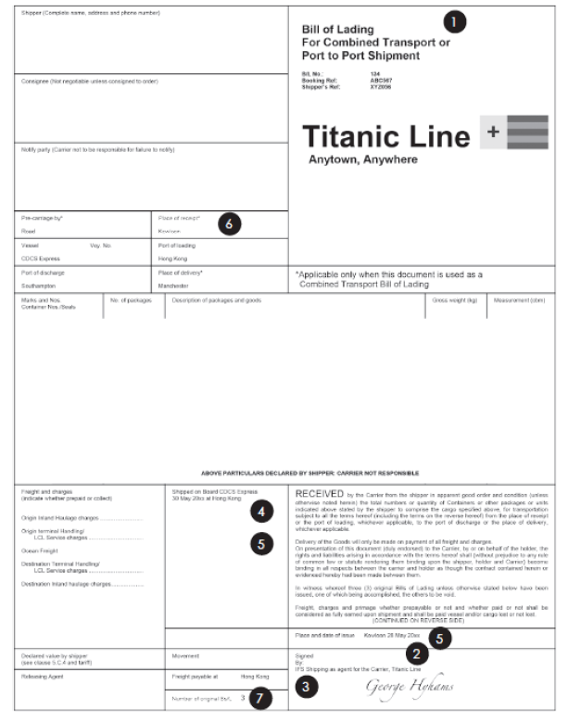
Examining transport documents
Examining a multimodal transport document (MMTD) : (ARTICLE 19 AND PARA D1)
A documentary credit requires the presentation of an MMTD covering shipment from Hong Kong port to Manchester.
1. However named – document can be titled multimodal transport document, combined transport document, through bill of lading, etc.
2. Name of the carrier – at the signature line, the carrier (Titanic Line) is identified.
3. Signed – the document is signed by IFS Shipping as agents of the carrier.
4. Evidence of shipment from Hong Kong – there is a dated on board notation indicating that the goods were shipped from Hong Kong port on 30 May 20XX.
5. Date of shipment – the document is issued on 28 May 20XX but the on board date is 30 May 20XX. The date of shipment is 30 May 20XX.
6. Although the documentary credit required shipment from Hong Kong to Manchester, the document indicates that the goods were received by the agent or the carrier in Kowloon. The carriage between Kowloon and Hong Kong port is outside the terms of the documentary credit. A document examiner is only interested in the carriage from Hong Kong port and when this occurred.
7. Full set – the document indicates that three originals have been issued.

Slide 95
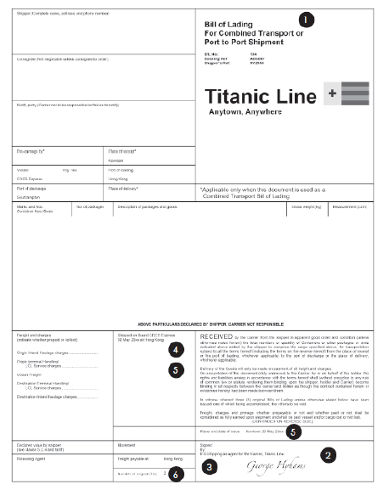
Examining transport documents
Examining a bill of lading (Article 20 and Para E1(a) ):
1. However named – document can be titled bill of lading, house bill of lading, forwarder’s bill of lading etc.
2. Name of carrier – at the signature line, the carrier (Titanic Line) is identified.
3. Signed – the document is signed by IFS Shipping as agents of the carrier.
4. Evidence of shipment from Hong Kong – there is a dated on board notation indicating that the goods were shipped from Hong Kong port on 30 May 20XX. The addition of a place of receipt that is different to the port of loading requires no additional information to appear as part of the on board notation.
5. Date of shipment – the document is issued on 28 May 20XX but the on board date is 30 May 20XX. The date of shipment is 30 May 20XX.
6. Full set – the document indicates that three originals have been issued.

Slide 96
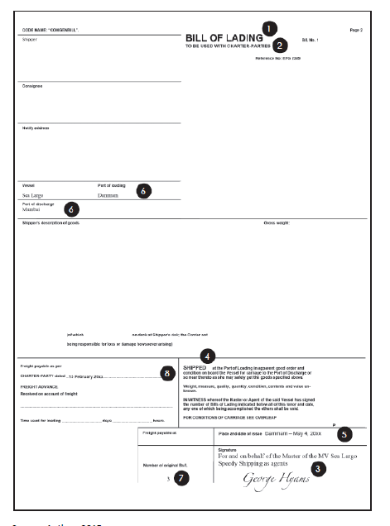
Examining transport documents
Examining a non-negotiable sea waybill (Article 21 and Para F1(a) ):
Article 21 is the rule to be applied when examining a non-negotiable sea waybill.
The provisions of article 21 are the same substantive requirements as those for bills of lading under article 20.
There is further detail in paragraph F1(a) as to when article 21 will apply.
Examining a charter party bill of lading (Article 22 and Para G1, G2):
A documentary credit requires or allows the presentation of a charter party bill of lading.
1. However named – document is called a bill of lading.
2. Indication of charter party – reference appears in the heading and in the freight field below.
3. Signed – the document is signed by an agent of the master of the named vessel.
4. Loading on board – there is pre-printed wording that the goods have been shipped at the port of loading.
5. Date of shipment – the date of issue will be deemed to be the date of shipment.
6. Port of loading and port of discharge – these are to be those stated in the documentary credit.
7. Full set – the document indicates that three originals have been issued.
8. Charter party contract – even if attached or requested under the documentary credit, it will not be examined.

Slide 97
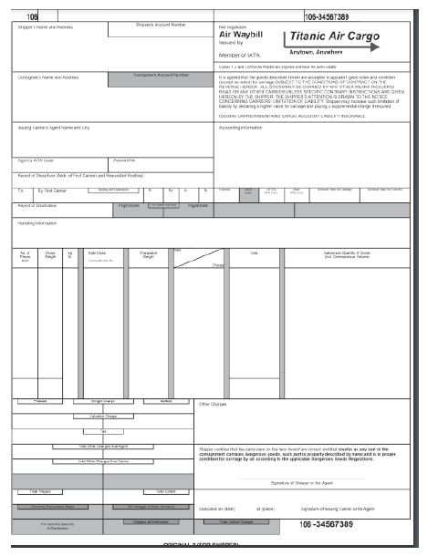
Examining transport documents
Examining an air transport document (Article 23 and Para H1 ,H2):
1. However named: Master Airway bill (MAWB) , House Airway Bill (HAWB)
2.Name of the carrier : For example, an International Air Transport Association (IATA) code for an airline without the name of the carrier would not be acceptable.
3.Signed by:
the carrier; or
a named agent for or on behalf of the carrier.
4. accepted for carriage: The document must indicate that the goods have been accepted for carriage
5. specific notation :If the documentary credit calls for an actual date of dispatch, a specific notation or stamp indicating that date must appear on the air transport document.
6. Date of shipment
7. airport of departure and airport of destination
8. original for consignor or shipper

Slide 98
Examining insurance, financial, commercial and official documents
Scrutiny of Insurance (Article 28): Ensure –
Certificate/policy is according to the letter of credit terms. In the case of policy, all negotiable copies are available.
Risk cover commences with effect from the date of shipment
The amount of insurance is as per the letter of credit terms. if not specified then at least 110% of the invoice value.
Whether drawn in the same currency as the letter of credit.
Description of goods agrees with the bill of lading
Risks as per the letter of credit are covered
The place where claims are payable is as per the letter of credit terms.
Adequately stamped
Details such as the name of the carrying vessel, port of loading/destination marks agree with the bill of lading.
If the insurance cover is under a blanket policy, a certificate of insurance clearly indicating the amount up to which the shipment related to the bill presented. In such cases, the LC should cover insurance certificates forming part of the blanket policy
The beneficiary must take out the policy with himself as 'assured'. A third-party policy must not be accepted unless stipulated in the LC.

Slide 99
Examining insurance, financial, commercial and official documents
Scrutiny of Draft/Bill of Exchange :Ensure –
It is dated and drawn on the bank as indicated in the letter of credit.
It is drawn and duly signed by the beneficiary of the credit, duly signed by the authorized signatory/ies. The signature should be verified
The drawing is within the letter of credit amount
Drawn in the same currency as per the letter of credit
Tenor is as per the letter of credit
The amount in words and figures are the same and identical to the amount stated in the invoice. For drafts that do not cover 100% of the invoice value, it should be ensured that the balance is realized within the time period stipulated as per regulations of the country concerned.
The superscription, regarding drawing under the letter of credit has been made
All corrections and alterations must be properly authenticated.
In respect of usance drafts it must be ensured that the requisite stamps have been affixed on the drafts as per stamps act applicable to the country of origin.
The draft should bear interest clause wherever necessary, or a separate draft for the interest portion attached.

Slide 100
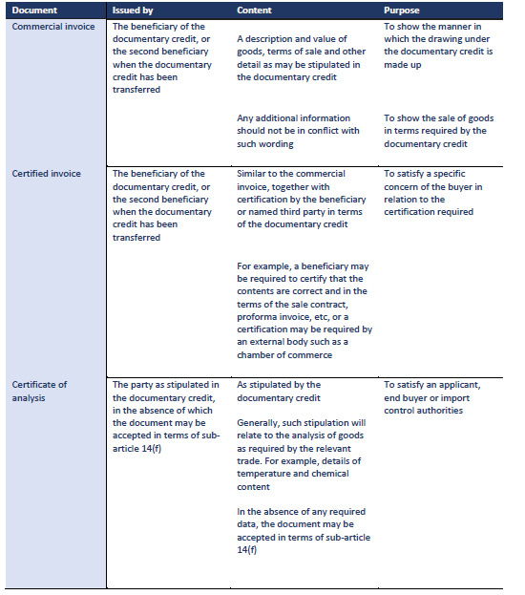
Examining insurance, financial, commercial and official documents
Scrutiny of Commercial Documents:

Slide 101
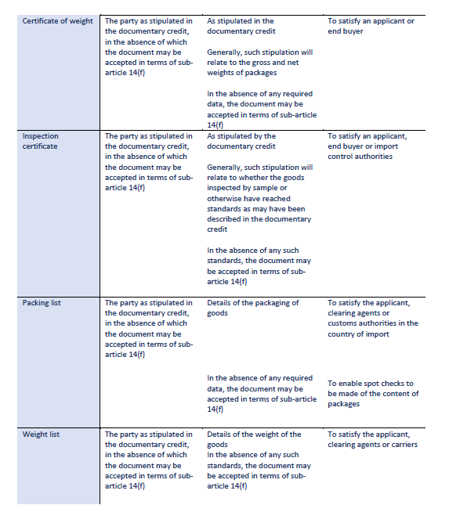
Examining insurance, financial, commercial and official documents
Scrutiny of Commercial Documents:

Slide 102
Examining insurance, financial, commercial and official documents
Scrutiny of Certificate of origin :Ensure
• that the certificate of origin appears to be signed, notarised, legalised, and visaed, as required by the documentary credit.
• that the data does not conflict with that appearing on any other stipulated document.
• that the country of origin is specified and that it meets the requirements of the documentary credit.

Slide 103
Common discrepancies that arise on examination of documents
Financial documents
The draft is not signed by the beneficiary.
The draft is signed, but there is no indication of the name of the beneficiary.
The draft has not been endorsed, as required.
The draft has not been drawn on the correct party.
The amount is in excess of that available under the documentary credit.
The tenor of the draft is shown incorrectly, for example: LC calls for a usance period 60 days ,the draft is for 90 days.
x days after the date of shipment and does not indicate the date of shipment.

Slide 104
Common discrepancies that arise on examination of documents
Commercial invoices
• The invoice was not issued by the beneficiary.
• The invoice is not signed, if so required by the documentary credit.
• The description of goods on the invoice does not correspond with the description shown in the documentary credit.
• The invoice is neither visaed nor legalised, as required by the documentary credit.
• The legalisation of the invoice is not in the terms required by the documentary credit.
• The breakdown of charges is not shown, as required by the documentary credit (where the documentary credit requires CIF charges to be shown separately).
• The quantity of goods shipped exceeds the tolerance of 5% under sub-article 30(b).
• The unit price is not as stipulated in the documentary credit.
• Partial shipment has been effected when prohibited by the documentary credit.
• The shipping marks and numbers on the invoice are in conflict with the shipping marks and numbers shown on the transport document.

Slide 105
Common discrepancies that arise on examination of documents
Certificates of analysis :
• The certificate contains data conflicting with the description of goods shown on the invoice and/or documentary credit.
• The certificate does not indicate the precise specifications and / or detail required by the documentary credit.
• The certificate has been issued by a party whose name is not as stipulated in the documentary credit.
Certificates of weight
• The weight shown is in conflict with that on the transport document or other stipulated document.
• The document submitted is not a certificate, but a listing.
Inspection certificates
• The certificate is not issued by the party stipulated in the documentary credit.
• The certificate shows data in conflict with the description of goods in the invoice and/or documentary credit.
• The wording of the certificate is not as stipulated by the documentary credit.
Packing lists
• The document indicates packing of goods that is not as required under the documentary credit, or as shown on the invoice or transport document
• The document contains data in conflict with that on other stipulated documents.
Weight lists
• The document indicates weight in conflict with that detailed on other stipulated documents.
• The document contains data in conflict with that on other stipulated documents.

Slide 106
Common discrepancies that arise on examination of documents
Certificate of origin
• The certificate indicates the origin of goods to be other than that stipulated in the documentary credit.
• The certificate was not issued by the party stipulated in the documentary credit.
• The certificate does not indicate that it has been legalised and visaed, as required by the documentary credit.
• The certificate’s legalisation was not in the terms specified under the documentary credit.
• The data on the certificate is in conflict with that on other stipulated documents.

Slide 107
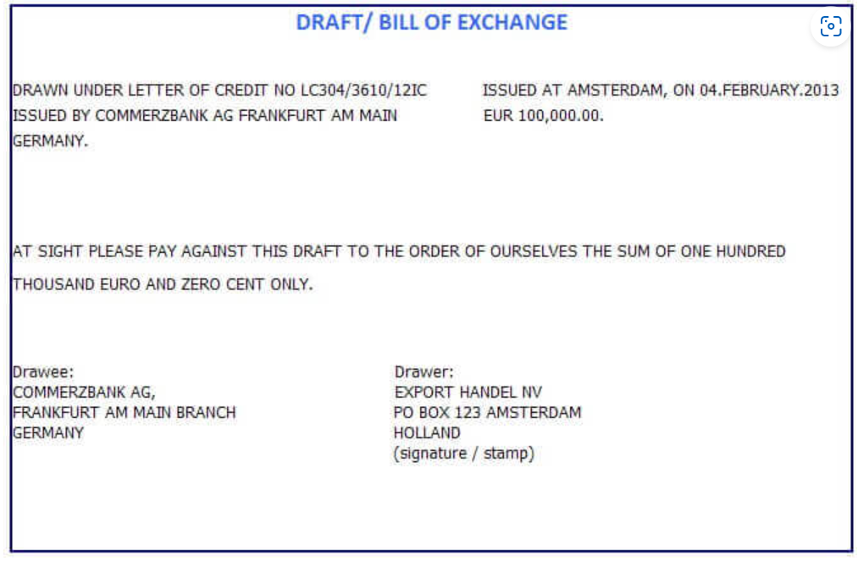
Negotiation / Honour
UCP 600 defines negotiation as follows:
“Negotiation means the purchase by the nominated bank of drafts (drawn on a bank other than the nominated bank) and/or documents under a complying presentation, by advancing or agreeing to advance funds to the beneficiary on or before the banking day on which reimbursement is due to the nominated bank.”
Example: the negotiation of a draft which is drawn under a letter of credit with the face value of EUR 100.000,00 as illustrated here.
ABN AMRO Bank is the nominated bank.
The beneficiary endorses the draft to ABN AMRO Bank, and ABN AMRO Bank discounts the draft by paying to the beneficiary EUR 95.000,00.
The transfer of the funds from the ABN AMRO Bank to the beneficiary constitutes a negotiation.
ABN AMRO Bank presents the draft and other letter of credit documents to the Issuing Bank.
If Issuing Bank determines that the presentation is complying, then the issuing bank must pay EUR 100.000,00 to ABN AMRO Bank.
If ABN AMRO Bank could not get the face value of the draft from the Issuing Bank, then ABN AMRO Bank may go back to Beneficiary to recover its EUR 95.000,00 payment.
ABN AMRO Bank, which is the nominated bank, discounts and pays the discounted letter of credit amount to the beneficiary with recourse basis.

Slide 108
Settlement
The settlement process of a documentary credit is driven by the presentation of complying documents. If complying documents are presented, UCP 600 requires that a bank act according to its own defined and agreed role or the undertaking that it may have given under that documentary credit.
Sub-article 6(b) requires that each documentary credit must state whether it is available by sight payment, deferred payment or acceptance (collectively referred to under the term honour) or by negotiation.
By sight payment :
A confirming bank must honour by effecting payment, and such honour is without recourse.
A nominated bank may or may not honour. Any honour of the presentation, by effecting payment to the beneficiary, is generally without recourse, unless the nominated bank has entered into a recourse agreement with that beneficiary.
An issuing bank must honour by effecting payment, and such honour is without recourse.
The documentary credit may or may not stipulate a requirement for a sight draft.
By deferred payment :
A confirming bank must honour by incurring a deferred payment undertaking and paying at maturity, and such honour is without recourse.
A nominated bank may or may not incur a deferred payment undertaking. When incurred, a deferred payment undertaking and its payment at maturity are without recourse.
An issuing bank must honour by incurring a deferred payment undertaking and paying at maturity, and such honour is without recourse.
The documentary credit will not stipulate a requirement for a draft.

Slide 109
Settlement
By acceptance :
A confirming bank must honour by accepting a draft drawn on it and paying at maturity, and such honour is without recourse.
A nominated bank may or may not accept a draft that is to be drawn on it. When accepted, a draft and its payment at maturity are without recourse.
An issuing bank must honour by accepting a draft drawn on it and paying at maturity, and such honour is without recourse.
By negotiation :
A confirming bank must advance funds or agree to advance funds to the beneficiary on or before the banking day on which reimbursement is due to it. Negotiation is effected without recourse.
A nominated bank may advance funds or may agree to advance funds to the beneficiary on or before the banking day on which reimbursement is due to it. Negotiation is effected either with or without recourse (usually with recourse).
An issuing bank cannot issue a documentary credit that is available with it by negotiation. An issuing bank can only pay at sight, accept a draft and pay at maturity, or incur a deferred payment undertaking and pay at maturity. An issuing bank does not negotiate.

Slide 110
Settlement
Complying documents :When a complying presentation has been made, a beneficiary can receive settlement from:
• a nominated bank that is willing to act on a nomination for it to honour or negotiate, and this bank will be reimbursed in accordance with the terms and conditions expressed in the documentary credit;
• a confirming bank, if any, which will honour or negotiate in accordance with the undertaking given in its advice of confirmation, and this bank will be reimbursed in accordance with the terms and conditions expressed in the documentary credit; or
• the issuing bank, which will honour a presentation made directly to it.
Notes:
These principles are covered in article 15. Note that a nominated bank and a confirming bank may be one and the same bank. The issuing bank will seek reimbursement from the applicant for any settlement made to a confirming bank, nominated bank or beneficiary in accordance with the arrangements agreed at the time the documentary credit is issued.

Slide 111
Settlement
Non-complying documents : If the presented documents do not comply and they are not capable of being corrected or replaced, no bank is under any obligation to honour or negotiate.
If documents are considered to be compliant by a nominated bank, but not by the confirming bank:
the confirming bank need not reimburse the nominated bank or may seek refund of any amount that the nominated bank has already received from the confirming bank; and
the nominated bank may be able to recover funds from the beneficiary if settlement was made with recourse.
If documents are considered to be compliant by a nominated bank, but not by the issuing bank:
the issuing bank need not reimburse the nominated bank, or may seek refund of any amount that the nominated bank has already received from the issuing bank or a reimbursing bank; and
the nominated bank may be able to recover funds from the beneficiary if settlement was made with recourse.
If documents are considered to be compliant by the confirming bank, but not by the issuing bank:
the issuing bank need not reimburse the confirming bank, or may seek refund of any amount that the confirming bank has already received from the issuing bank or a reimbursing bank; and
the confirming bank cannot recover funds from a nominated bank or beneficiary, because its settlement was made without recourse.
Notes:
These principles are covered in article 15. Note that a nominated bank and a confirming bank may be one and the same bank. The issuing bank will seek reimbursement from the applicant for any settlement made to a confirming bank, nominated bank or beneficiary in accordance with the arrangements agreed at the time the documentary credit is issued.

Slide 112
Settlement
If documents are considered to be compliant by the issuing bank, but not by the applicant:
the applicant need not reimburse the issuing bank, or may seek refund of any amount that has already been debited to its account; and
the issuing bank cannot recover funds from the confirming bank, a nominated bank or the beneficiary, because its settlement was made without recourse.
Notes:
These principles are covered in article 15. Note that a nominated bank and a confirming bank may be one and the same bank. The issuing bank will seek reimbursement from the applicant for any settlement made to a confirming bank, nominated bank or beneficiary in accordance with the arrangements agreed at the time the documentary credit is issued.

Slide 113
Settlement by Bank Role
Settlement by a named nominated bank :
If a documentary credit is in the currency of the country in which both the nominated bank and the beneficiary are located, the bank may be able to debit the account of the issuing bank and effect payment in terms of the beneficiary’s instructions.
If a documentary credit is in another currency and stipulates that a reimbursement claim is to be made directly to the issuing bank, the nominated bank’s claim will indicate the details of where the issuing bank is to make payment.
Settlement by a confirming bank : Most of the comments made in respect of a named nominated bank will also apply to a confirming bank.
the confirming bank is required to effect settlement to the beneficiary in accordance with the terms and conditions of the documentary credit and of its confirmation, and in doing so it will attempt to match the value date of the payment to the beneficiary with the date on which it expects to receive reimbursement from the issuing bank or a reimbursing bank.
Notes:
These principles are covered in article 15. Note that a nominated bank and a confirming bank may be one and the same bank. The issuing bank will seek reimbursement from the applicant for any settlement made to a confirming bank, nominated bank or beneficiary in accordance with the arrangements agreed at the time the documentary credit is issued.

Slide 114
Settlement by Bank Role
Settlement by any bank in a freely available documentary credit: The claims procedure by a bank nominated in the circumstances of a freely available documentary credit are also the same as those for a named nominated bank. The one exception is that there may be no ability to debit the account of an issuing bank, unless such nominated bank is also the advising bank and therefore the holder of any accounts in the name of the issuing bank.
Settlement by an issuing bank : The issuing bank is required to reimburse the nominated bank and, sometimes, to honour a presentation made directly by or on behalf of the beneficiary. In these circumstances, the issuing bank cannot escape liability for any delay in effecting settlement.
Notes:
These principles are covered in article 15. Note that a nominated bank and a confirming bank may be one and the same bank. The issuing bank will seek reimbursement from the applicant for any settlement made to a confirming bank, nominated bank or beneficiary in accordance with the arrangements agreed at the time the documentary credit is issued.

Slide 115
Refusing documents
If the issuing bank determines that the documents do not comply, it has two options:
1. it may refuse the documents and give notice of refusal to the presenter; or
2. it may first seek applicant waiver of the discrepancies.
(Depending on receipt of waiver) take up or refuse and give notice :if the applicant has not provided its waiver of discrepancies within the time frame prescribed by the issuing bank, the issuing bank must make a decision as to whether it will take up or refuse the documents.
If the issuing bank waives the discrepancies :if the issuing bank decides on its own to waive the discrepancies, it must take up the documents. It does not bind the issuing bank to honour subsequent drawings with the same discrepancies under that or any other documentary credit.
If the issuing bank refuses the documents : if the issuing bank decides to refuse the documents, it must send a notice of refusal in accordance with sub-articles 16(c) and (d).
Notes:
confirming bank or nominated bank acting on its nomination will also make the above assessments as to whether to take up the documents or to issue a notice of refusal to the presenter.

Slide 116
Refusing documents
(If waiver received) determine whether or not to accept the applicant waiver :if the applicant conveys its waiver of discrepancies, the issuing bank must then make its decision as to whether it will agree to accept it. Even if an applicant waives the discrepancies, the issuing bank is not required to accept such waiver.
If the issuing bank agrees to accept the applicant’s waiver of the discrepancies :it must take up the documents despite the discrepancies that it had identified and honour or reimburse.
If the issuing bank does not accept the applicant’s waiver : it must send its notice of refusal.
Note: the notice of refusal is usually transmitted by SWIFT MT734 message which is titles as ‘Advice of Refusal’, there is no need for the content of the message to indicate ‘We refuse’ or words of similar intent.
Notes:
It should be noted that if the issuing bank decides not to accept the applicant’s waiver, where a notice of refusal has already been issued, it should inform the presenter of this decision and seek further instructions for the handling of the documents.
Performance under the rules When the issuing bank performs according to article 16, there is no risk provided that it conforms specifically to the steps outlined for examination, waiver and notice.

Slide 117
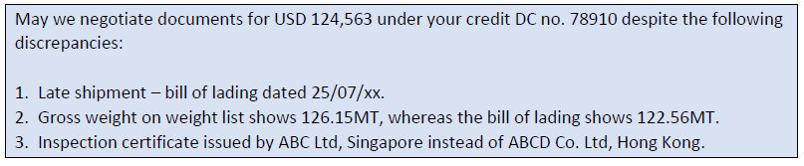
Refusing documents
Receiving prior requests from a nominated bank for authority to honour or negotiate :
If a nominated bank finds discrepancies in the presented documents for it to ask the issuing bank for authority to honour or negotiate, despite those discrepancies .
These requests are often sent in the form of a SWIFT MT750 message and include wording along the following lines.
If the applicant gives approval in the form of a waiver and the issuing bank agrees to accept the waiver, the issuing bank may reply to the request in the following terms using a SWIFT MT752 message:

Slide 118
The risks involved in documentary credit transactions
1. The risks faced by an applicant :
Non-delivery of goods as described in the presented documents
Short-shipment, or shipment of inferior goods
Loss or damage to goods in transit
Foreign exchange risk
Failure of the issuing bank
Fraud in the presented documents
Goods received by the applicant prior to documents being received by the issuing bank

Slide 119
2. The risks faced by a beneficiary
Failure to comply with the terms and conditions of the documentary credit
Failure of, or delays in settlement from, the issuing bank
Documentary credit issued by an entity other than a bank
Fraud
Foreign exchange risk

Slide 120
3. The risks applicable to an issuing bank
Applicant risk – the applicant may be unable to reimburse the bank for any settlement or reimbursement that it is required to make in respect of a presentation that complies with the terms and conditions of the documentary credit, or in respect of a presentation under which the applicant had previously issued a waiver of discrepancies and that waiver was acceptable to the bank.
Financial crime – the documentary credit may be used to facilitate criminal activity (that is, money laundering, fraud against the bank and / or other entities, terrorist financing, etc).
Errors in conveying the requirements of the customer
Any errors in rekeying will be the responsibility of the issuing bank
Errors in document examination or a failure to follow the requirements of article 16 when refusing documents

Slide 121
4. The risks applicable to an advising bank - An advising or second advising bank undertakes no obligation to honour or negotiate and therefore incurs no credit risk by advising a documentary credit or an amendment.
5. The risks applicable to a confirming bank :
Issuing bank risk – the issuing bank may be unable to reimburse the bank for any settlement or reimbursement that it is required to make in respect of a presentation that complies with the terms and conditions of the documentary credit, or in respect of a presentation where the applicant had previously issued a waiver of discrepancies, and that waiver was acceptable to the issuing bank and the confirming bank was willing to continue with its confirmation.
Financial crime – the transaction may be used to facilitate criminal activity, such as money laundering, fraud against the bank and / or other entities, terrorist financing, etc.
Errors in conveying the requirements of the issuing bank
Errors in document examination or a failure to follow the requirements of article 16 when refusing documents

Slide 122
The related products used in documentary credit transactions:
Letter of Indemnity
Air Way Release
Shipping Guarantee

Slide 123
Shipping Guarantee
An issuing bank may not receive documents under its documentary credit prior to the goods arriving at their destination.
This means, for example, that an applicant may not be in possession of an original bill of lading when the vessel arrives at the port of discharge.
Unless the goods are cleared from the port with the minimum of delay, the port authorities may:
• levy charges (eg demurrage) and the rate of charge may increase the longer the goods remain at the port; and
• in a worst-case scenario, confiscate goods after the expiration of a stated statutory period.
To clear the goods carrier will ask for the indemnity .
Applicant may request its bank to issue the indemnity in a format that will be satisfactory to the carrier which is called shipping guarantee.

Slide 124
Airway release and delivery orders
An airway release deals with the delivery of goods dispatched by air.
A delivery order deals with the delivery of goods dispatched by modes other than sea and air, and are generally seen in respect of goods dispatched by road.

Slide 125
Letter of Indemnity (LOI)
An LOI is usually seen in commodity trades, such as oil, in which the cargo can be sold many times before it is delivered to the end buyer.
A documentary credit covering a shipment, such as oil, will provide a list of the documents that are required in order for the beneficiary to be paid. This list will include documents such as a commercial invoice and a full set of charter party bills of lading.
It will also often indicate that, should the charter party bills of lading not be available at the time of presentation or payment, the beneficiary may present an LOI and a commercial invoice in lieu of the listed documents
If the beneficiary presents its invoice and LOI, settlement is made against these documents only.
an LOI is usually issued by the beneficiary of the documentary credit and, if required, countersigned by its bankers
The LOI is generally a one-page document that:
• confirms the issuer’s ownership rights over the goods;
• indemnifies the party to which it is addressed against the absence of a full set of original charter party bills of lading;
• undertakes to surrender such full set of charter party bills of lading as soon as they are received; and
• agrees to hold the addressee harmless and indemnified against all consequences resulting from the sale and the absence of a full set of original charter party bills of lading.

Slide 126
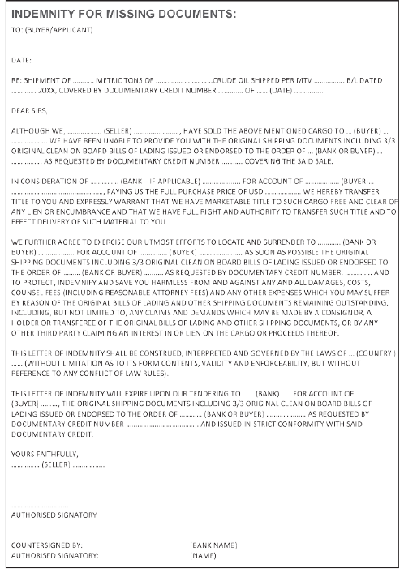
Sample LOI:

Slide 127
Money Laundering
The term ‘money laundering’ is used to refer to all techniques used to conceal the origin of money that has been illegally obtained or which is being used for illegal purposes.
One technique is to use the proceeds of crime as a cash deposit to induce a bank to issue a documentary credit covering the purchase of goods, from a legitimate seller, which will then be sold in the local market. The proceeds of such a transaction will then be perceived as clean.
Money launderers use a variety of other techniques to achieve their objectives, including the following.
- Cash Transactions- cash can be deposited into bank accounts in jurisdictions with greater bank secrecy or a less rigorous anti-money-laundering environment.
-Under- or overvaluing invoices – inflating the true value of an invoice can disguise the movement of illegal funds.
-Shell companies and trusts – these can disguise the true owner of funds, especially if the jurisdiction in which the shell company or trust is located does not require the disclosure of the beneficial owner.
- Bank capture – in extreme cases, money launderers may have a controlling interest in a bank, allowing them to move funds without scrutiny.
To achieve this, the money launderer may try to use all of the normal trade finance services offered by a bank to legitimate import–export businesses.

Slide 128
The practice of terrorist financing
Financial support for terrorist activities may come directly from certain states or jurisdictions, or from organisations large enough to be able to collect and make the funds available to the terrorist organisation.
Terrorism may also be funded from sources channelled more directly through the financial system .
A terrorist organisation may even engage in revenue-generating activities of its own, which often may be – or certainly appear to be – legitimate businesses .
From the perspective of a bank engaged in a documentary credit, the main challenge is to ‘know its customer’ to try to identify the true beneficial owners of the parties involved and to ensure that the transaction is in line with its normal course of business.
Banks therefore need to adopt procedures to ensure that they:
• know their customers;
• know the beneficial owners of parties to any transaction; and
• understand the nature of any underlying business relationship and transaction.
The lead international body in the fight against money laundering and terrorist financing is the Financial Action Task Force (FATF).
maintains a list of higher-risk countries (that is, those in which it assesses anti-money-laundering and counter-terrorist financing rules to be insufficiently robust). If a correspondent bank is located in one of these countries, banks have a greater responsibility to conduct enhanced scrutiny of their counterpart(s).

Slide 129
Sanctions
International sanctions can have a significant impact on the payment obligation under a documentary credit.
Economic sanctions, in the form of trade restrictions, are sometimes imposed on countries or individuals by the United Nations, OFAC (Office of Foreign Assets Control), the European Union or governments (either acting alone or jointly with others).
if sanctions are imposed and a bank considers the transaction to be subject to those sanctions, the bank will not honour or negotiate. This applies whether or not a sanctions clause is included in the documentary credit.
Country names: North Korea, Cuba ,Iran, Syria,

Slide 130
Letter of Credit-SWIFT Messages

Slide 131
Collection

Slide 132
Collection- Agenda
Definition
Difference with LC
Collection Life Cycle and Activities

Slide 133
Collection
In trade finance, a collection refers to the process of handling documents and payments involved in the transfer of goods from a seller to a buyer. It is a payment method used in international trade, in which a bank acts as an intermediary to facilitate the transaction between the parties.

Slide 134
How Collection is different from LC
Collection is a process where the seller ships the goods to the buyer and sends the shipping documents to their bank, which acts as an intermediary between the buyer and seller to facilitate payment. The bank then forwards the documents to the buyer's bank, which releases the payment to the seller once the documents are accepted. This method does not provide the same level of security as a letter of credit, as the buyer can still default on payment after the documents are released.
On the other hand, a letter of credit is a financial instrument issued by a bank that guarantees payment to the seller once the seller provides the required documents to prove that they have fulfilled the terms of the agreement. In this method, the buyer's bank issues a letter of credit to the seller's bank, guaranteeing payment upon receipt of the required documents. This provides a higher level of security to the seller, as the bank's obligation to pay is independent of the buyer's willingness or ability to pay.

Slide 135
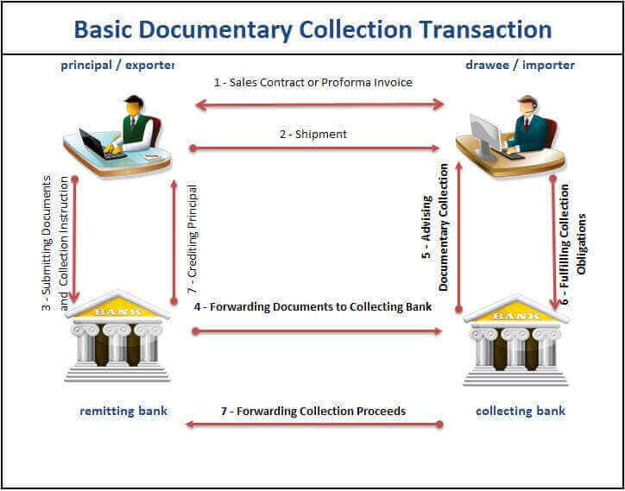
Collection Life Cycle and Activities

Slide 136
Payments

Slide 137
Methods of Payment in Trade Finance
In international Trade there are risk to both the buyer and the seller. The seller runs the risk of payment not being made after the goods have been delivered and the buyer runs risk of not getting the goods or getting of different type after the payment has been affected.
The amount of risk which the buyer or the seller faces will depend upon the terms and conditions of the payment.
The risk will depend upon how closely the time of payment could be matched with the time of release of goods.

Slide 138
Methods of Payment in Trade Finance- Cont.
The following are the various recognized ways of effecting payment in international Trade:
Advance Payment
Open Account
Documentary Collection
Against Payment
Against Acceptance
Documentary Credit or Letter of Credit .
Against Payment
Against Acceptance

Slide 139
Collection Payments

Slide 140
1. Clean Payments
In the case of Clean Payment transactions, all shipping documents, including title documents are handled directly by the trading parties, the role of banks is limited to clearing funds as required, the two types of Clean payments are
Advance Payment - The Buyer makes payment for the goods (full or partial) even before the goods are shipped.
Open Account - Seller will dispatch the goods to the buyer and the buyer will make payment for the goods (in full or part) in the future at an agreed date.

Slide 141
Parties of Advance Payment & Open Account
Buyer
One who buys the Goods and pays the Seller for that.
Seller
One who sells the Goods and receives money from Buyer.
Buyer Bank and Seller Bank
Funds Transfer from Buyer to Seller

Slide 142
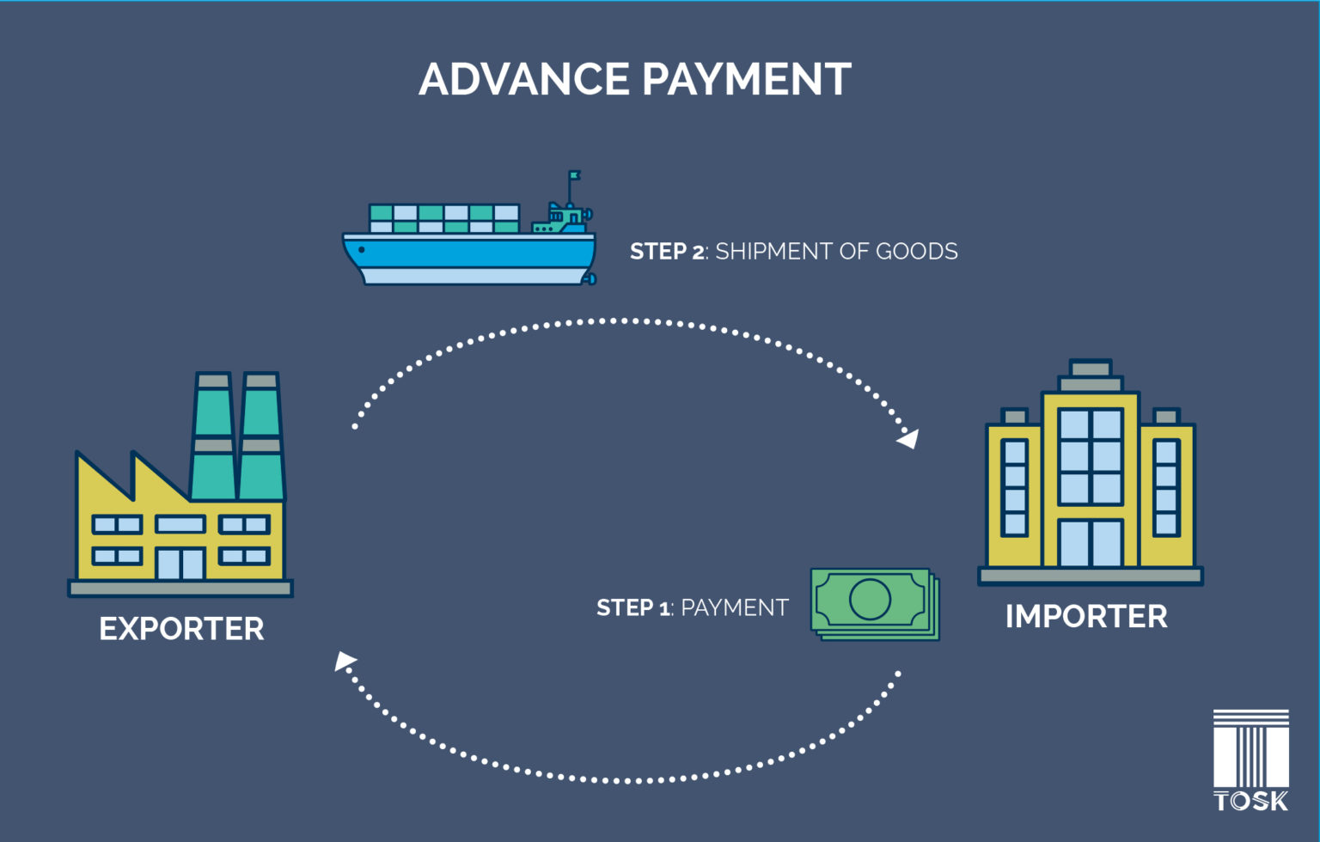
Cycle of Advance Payment
The buyer and seller enter into an agreement for dispatch of goods, terms and conditions and settlement / payment for the goods.
The buyer makes payment (full or partial) through his bank for the goods even before the goods are dispatched.
The seller dispatches the goods only after receipt of advance payment.
Source: Maveric-Systems

Slide 143
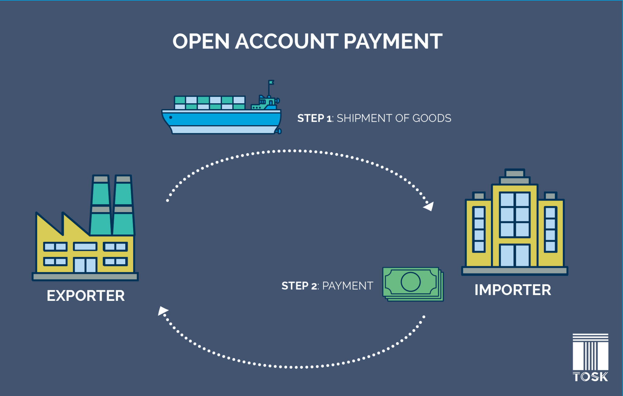
Cycle of Open Account
The buyer and seller enter into an agreement for dispatch of goods, terms and condition and settlement / payment for the goods.
The seller dispatches the goods to the buyer.
The buyer makes payment through his bank for the goods at a future date as per the agreement.
The seller may continue to dispatch goods to the buyer up to an agreed overall limit.
The goods are consigned directly to the buyer so that the buyer could take delivery of the same.
Source: Maveric-Systems

Slide 144
2. Documentary Collection
URC 522 governs the operation of Documentary Collections.
A documentary collection is a process, in which the seller instructs his bank to forward documents related to the export of goods to the buyer's bank with a request to present these documents to the buyer for payment, indicating when and on what conditions these documents can be released to the buyer.
Collections - Documents against Payment (D/P)
Both the buyer and the seller agrees that the seller will dispatch the goods to the buyer (through the Bank) and forward the documents to the buyer’s bank and the buyer will make payment for the goods (in full or part) and take delivery of the goods.
Collections - Documents against Acceptance (D/A)
Both the buyer and the seller agrees that the seller will dispatch the goods to the buyer (through the Bank) and forward the documents to the buyer’s bank and the buyer will accept the bill of exchange and take delivery of the goods. The buyer will make payment for the goods (in full or part) at an agreed future date.

Slide 145
Parties of Documentary Collection
The Seller: ( Drawer )
This is the party who is the initiator of the collection process.
In most of the cases he is the supplier / exporter / drawer of the bill of exchange.
Remitting Bank:
It is the Bank (normally the Principal’s banker) that sends the collection and collect the amount from the drawee on behalf of the drawer.
Collecting Bank:
Generally, the Bank in the buyer’s country.
Receive the collection from the remitting bank and informs the drawee of the respect of the collection with a request to make payment as per the terms and conditions of the collection.
Undertake the responsibility for remitting the amount collected from the drawee to the remitting bank.

Slide 146
Parties of Documentary Collection- Cont.
Presenting Bank:
It is the Bank that makes documents available to the buyer (the drawee) in terms of the instructions received from the remitting bank.
In case the drawee do not maintain an account with the collecting bank, the collecting bank forwards the documents / collection to the buyer’s bank, which assumes the role of the presenting bank.
As per URC Presenting bank is also the Collecting bank.
The Buyer: ( Drawee )
The person or entity named as the Drawee or Importer under the collection.
In most of the cases he is the person / entity who has imported / bought the goods / services and is responsible for making the payment under the collection.

Slide 147
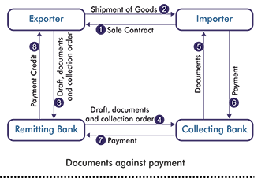
Documentary Collection Payment on Sight Basis (D/P)
The drawee is usually expected to pay within 5 working days of presentation.
The instructions to the shipping documents should show “Release Documents Against Payment”
The buyer authorizes payment, and the collecting bank remits the proceeds to the remitting bank and releases the documents to the buyer, so that the goods may be collected.
The remitting bank credits the amount to the account of the seller under advice.

Slide 148
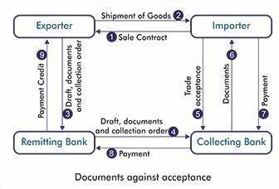
Documentary Collection Payment on Usance Basis (D/A)
The payment date is calculated from the term of the bill, which is usually a multiple of 30 days and start either from sight or form the date of shipment, whichever is stated on the bill of exchange.
The instruction to the shipping document should show "Release Documents Against Acceptance“.
On the due date the buyer makes the payment against the documents.
The remitting bank credits the amount to the account of the seller under advice.

Slide 149
Usance D/P
A Usance D/P Bill is an agreement where the buyer accepts the bill payable at a specified date in future but does not receive the documents until he has actually paid for them. The reason is that airmailed documents may arrive much earlier than the goods shipped by sea.
The buyer is not responsible to pay the bill before its due date, but he may want to do so, if the ship arrives before that date. This mode of payments is less usual but offers more settlement possibility.
These are still D/P terms so there is no extra risk to the exporter or his bank. As an alternative the covering scheduled may simply allow acceptance or payments to be deferred awaiting arrival of carrying vessel.

Slide 150
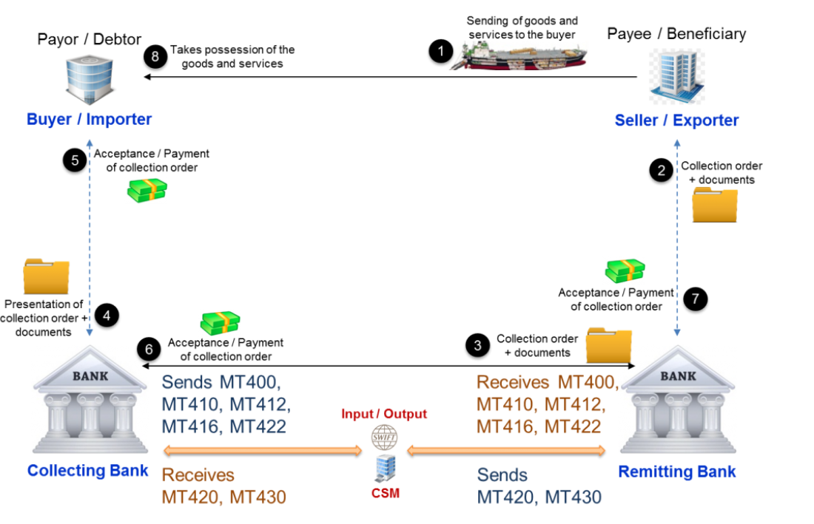
SWIFT Messages Exchanged for a Documentary Collection
The SWIFT category 4 messages are used for documentary collections.

Slide 151
SWIFT Category 4 messages

Slide 152
Difference between Clean Collection and Documentary Collection
Clean Collection | Documentary Collection
All shipping documents, including title documents are handled directly by the trading parties, the role of banks is limited to clearing funds as required. | An exporter's bank forwards documents to an importer's bank and collects payment for shipped goods.
Substantial risk for importer/exporter is greater here | Risk compared to clean collection is less

Slide 153
LC Payments

Slide 154
Introduction To LC & Governing Rules
Letter of Credit :
A documentary credit is an agreement under which a bank acting at the request and on instructions of the Importer/Buyer/Applicant makes an undertaking to effect payment to the Exporter/Seller/Beneficiary against presentation of the required documents as per LC within the specified period of time, provided that the documents strictly comply with the terms and conditions of the credit, the applicable provisions of these rules (UCP) and International Standard Banking Practices .
UCP 600 -
Documentary credits are regulated by the International Chamber of Commerce(ICC) through the Uniform Customs and Practices for Documentary Credits, 2007 Revision, ICC Publication No. 600 . UCP is the Rules to be followed under the LC .
URR 725 :
The Uniform Rules for Bank-to-Bank Reimbursements under Documentary Credits, ICC Publication No. 725, shall apply to any bank-to-bank reimbursement under documentary credits, when the reimbursement authorization expressly indicates that it is subject to these rules.
ISBP 745 :
International Standard Banking Practices : ISBP your “manual” to on how use the UCP and an integral part of working with Letters of Credit. ISBP 2013 published by ICC with the ICC Publication No. 745. ISBP is the principles and be useful while examining the documents presented under the LC.

Slide 155
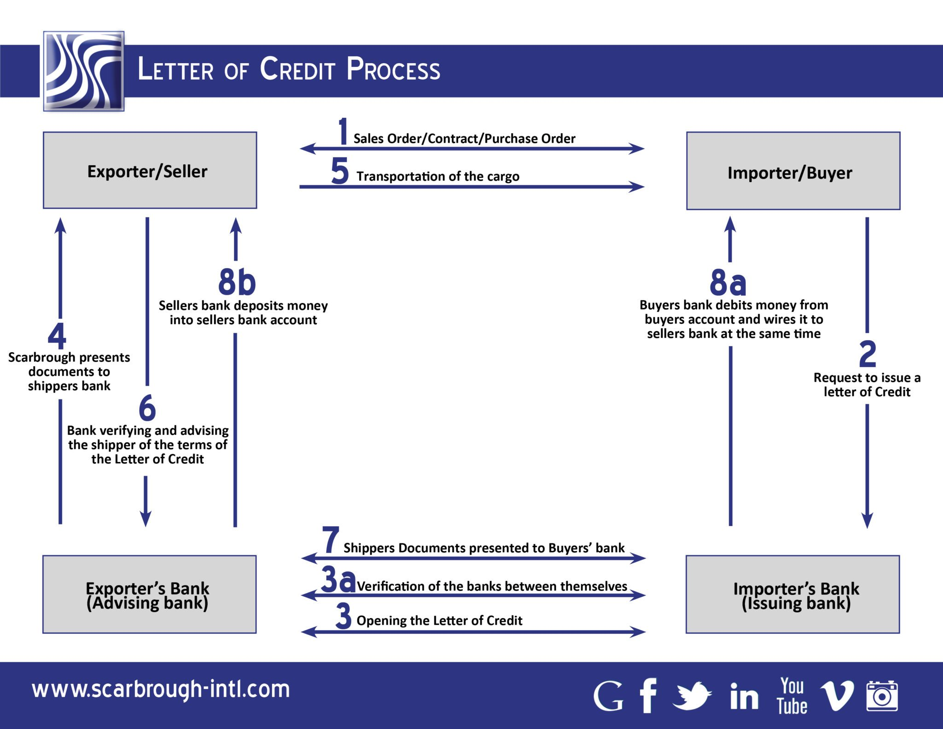
LC Cycle

Slide 156
LC Payment Terms
LC Payment Terms
Sight LC
Usance LC
Seller/Bene will get the payment under the LC – once the presented documents are credit complaint as per LC, UCP & ISBP (Immediately – 5 to 10 days)
Usance is the allowable period of time as stated in the LC. Seller /Bene will get the payment under the LC on maturity date for the credit complaint documents

Slide 157
Ways of Payment under the LC
Issuing Bank can make the payment to the Beneficiary to his bank through the below ways as per the coering schedule or LC instruction
LC Payment Instruction
Vostro (Debit Authorization)
Claim
Nostro(MT202)
Issuing Bank will hold the account with Nego/Nominated/Presenting Bank , and on credit complaint documents , Issuing bank will authorise the NB to debit Issuing bank account with NB
Reimbursement authorization” means an instruction or authorization, issued by an issuing bank to a reimbursing bank to reimburse a claiming bank or, if so requested by the issuing bank, to accept and pay a time draft drawn on the reimbursing bank
Issuing Bank will make the payment to presenting bank/nominated bank through swift payment (MT202) via nostro account.

Slide 158
Debit Authorization/Vostro
Vostro :Vostro is a reference to "yours" and refers to "your(Issuing Bank) money that is on deposit at our bank(Nominated/Nego/Presenting Bank) ." A vostro account is like any other account held by a bank. The account is a record of money owed to or maintained by a third party, typically another bank, but it can be either a company or an individual
Steps
Issuing Bank will hold account with Nego/Confirming/Presenting Bank
Once the docs are submitted by the Nego/Confirming/Presenting Bank issuing bank will check the docs.
If the docs are credit complaint then issuing bank will authorize the Nego / Confirming / Presenting Bank to debit their account with Nego/Confirming/Presenting Bank for the document value through MT752 (Issuing bank will debit the applicant and credit their account with Nego/Confirming/Presenting Bank )
Once MT752 is received , Nego/Confirming/Presenting Bank will debit the Issuing bank account with themselves and credit the beneficiary.

Slide 159
Reimbursement Claim
Reimbursing bank is the bank that, at the request of the issuing bank, is authorized to pay, or accept and pay time draft under a documentary credit in accordance with UCP 600 article 13 (URR 725).
Steps :
Issuing bank issues the letter of credit and transmits it to the nominated bank via swift message.
Issuing bank gives reimbursement authorization to reimbursing bank.
Reimbursing bank issues its reimbursement undertaking and transmits it to the nominated bank via swift message.
Nominated bank advices the letter of credit to the beneficiary. (please keep in mind that step 3 and step 4 may be change their sequence)
Beneficiary presents documents to the nominated bank.
Nominated bank checks the documents and negotiate upon a complying presentation.
Nominated bank sends it reimbursement claim to the reimbursing bank. Reimbursing bank reimburse nominated bank according to terms and conditions of the reimbursement undertaking.
Nominated bank send documents to the issuing bank.
On the final stage issuing bank and reimbursing bank arrange settlement between themselves. Issuing bank gets the letter of credit amount from the applicant and releases original shipment documents

Slide 160
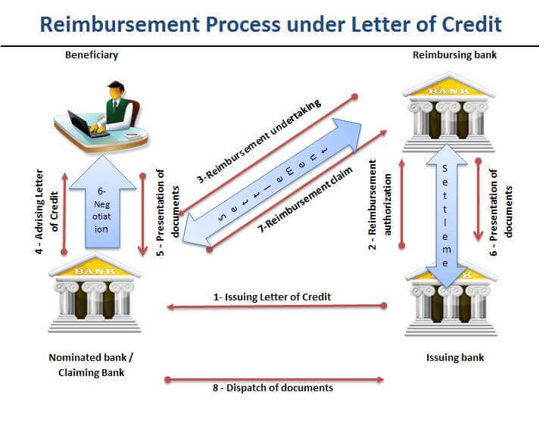
Reimbursement Claim Work-Flow

Slide 161
SWIFT PAYMENT/NOSTRO
There are two methods of swift payment
Methods of Payment
Serial Method
Cover Method
Only one message is initiated by the sender to settle the funds. That message moves from one party to the next in the payment chain until it reaches the beneficiary bank
Two messages are initiated by the sender to settle the funds. One message is used to inform the creditor bank that funds are coming. It is called an announcement. The other message, called cover message, moves the funds between correspondent accounts.

Slide 162
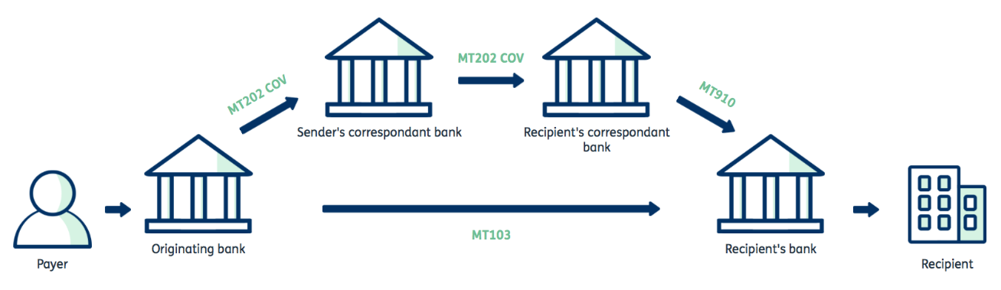
SWIFT Messages MT103/202

Slide 163
Parties Involved in MT103/202
Sending Institution : This field identifies the Sender of the message.
Ordering Institution : This field specifies the financial institution of the ordering customer, when different from the Sender, even if field 50a contains an IBAN.
Sender's Correspondent : Where required, this field specifies the account or branch of the Sender or another financial institution through which the Sender will reimburse the Receiver.
Receiver's Correspondent : This field specifies the branch of the Receiver or another financial institution at which the funds will be made available to the Receiver.
Third Reimbursement Institution:This field specifies the Receiver's branch, when the funds are made available to this branch through a financial institution other than that indicated in field 53a.
Intermediary Institution : This field specifies the financial institution through which the transaction must pass to reach the account with institution.
Account With Institution: This field specifies the financial institution which services the account for the beneficiary customer. This is applicable even if field 59a contains an IBAN.
Beneficiary Institution : This field specifies the financial institution which has been designated by the ordering institution as the ultimate recipient of the funds being transferred.
Beneficiary Customer : This field specifies the customer which will be paid. Usually, the bene

Slide 164
Swift Messages Used for Payment – MT103
MT103 – SINGLE CUSTOMER CREDIT TRANSFER
This message type is sent by or on behalf of the financial institution of the ordering customer, directly or through (a) correspondent(s), to the financial institution of the beneficiary customer.
It is used to convey a funds transfer instruction in which the ordering customer or the beneficiary customer, or both, are non-financial institutions from the perspective of the Sender.
Status | Tag | Field Name
M | 20 | Sender's Reference
O | 13C | Time Indication
M | 23B | Bank Operation Code
O | 23E | Instruction Code
O | 26T | Transaction Type Code
M | 32A | Value Date/Currency/Interbank Settled Amount
O | 33B | Currency/Instructed Amount
O | 36 | Exchange Rate
M | 50a | Ordering Customer
O | 51A | Sending Institution
O | 52a | Ordering Institution
O | 53a | Sender's Correspondent
O | 54a | Receiver's Correspondent
O | 55a | Third Reimbursement Institution
O | 56a | Intermediary Institution
O | 57a | Account With Institution
M | 59a | Beneficiary Customer
O | 70 | Remittance Information
M | 71A | Details of Charges
O | 71F | Sender's Charges
O | 71G | Receiver's Charges
O | 72 | Sender to Receiver Information
O | 77B | Regulatory Reporting
M = Mandatory, O = Optional - Network Validated Rules may apply

Slide 165
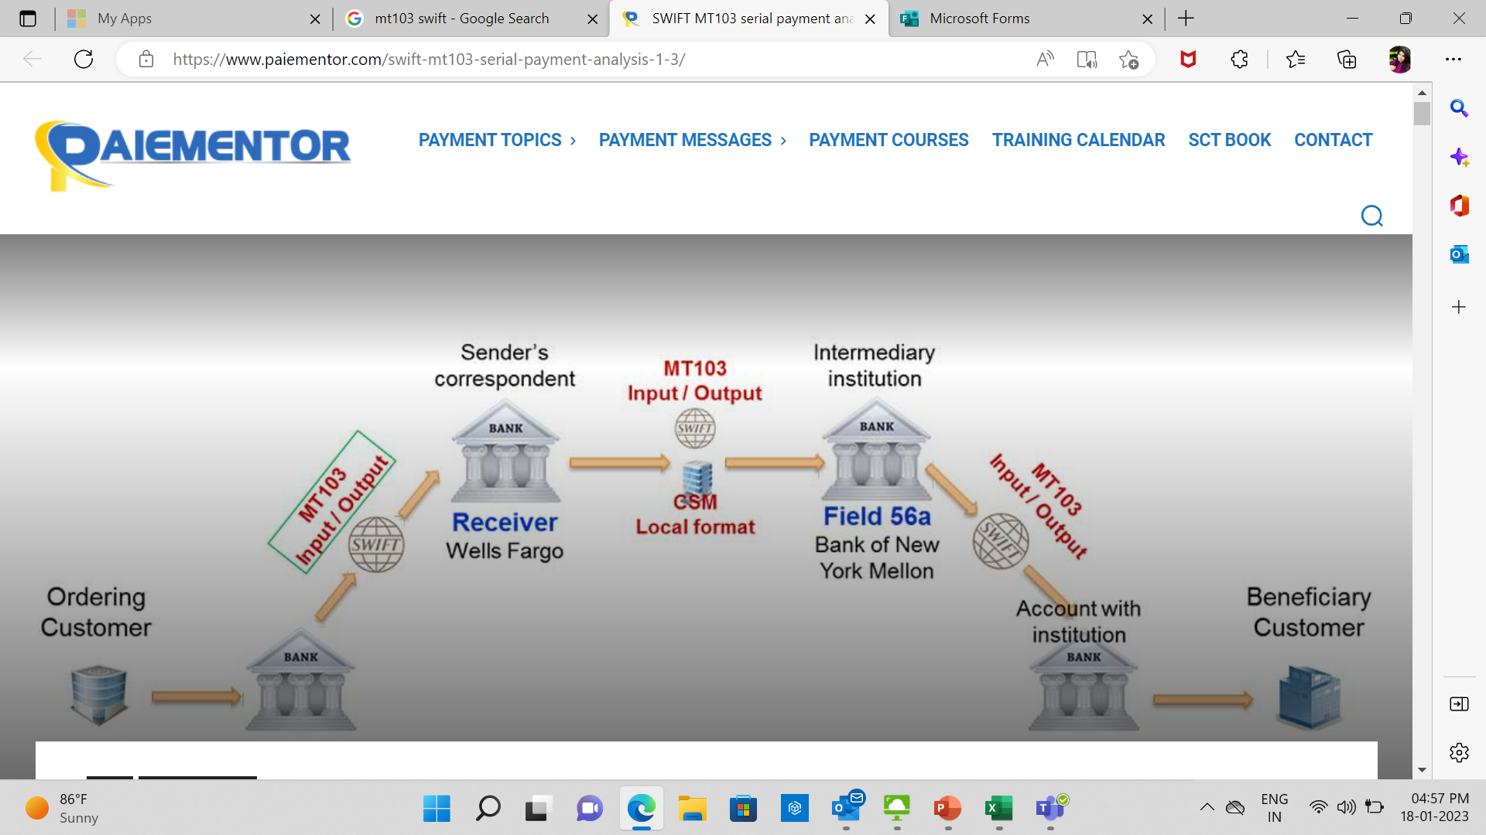
MT103 - Flow

Slide 166
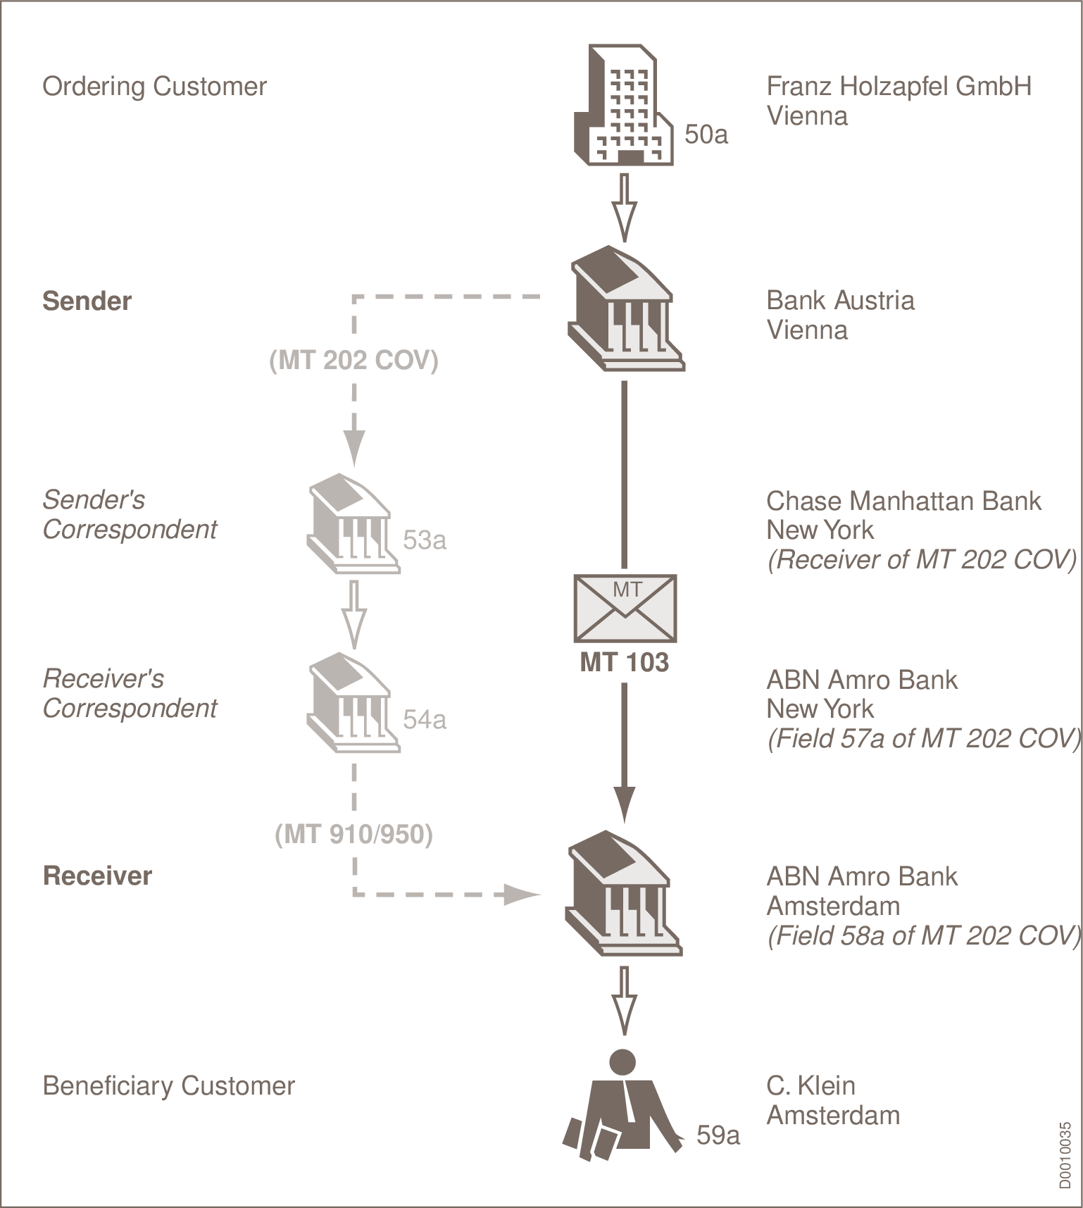
MT103 Example
Bank Austria sends the following messages:
A customer transfer to ABN Amro Bank, Amsterdam.
A cover message for the US dollar payment, which is provided through Chase Manhattan Bank, New York, to ABN Amro Bank, New York.
BKAUATWW agreed on the Standard Service Level, as did its Dutch correspondent ABNANL2A.

Slide 167
MT202 – SWIFT PAYMENT
An MT202 is a standardized SWIFT payment message used to instruct the transfer of funds between financial institutions. Requests the movement of funds between financial institutions, except if the transfer is related to an underlying customer credit transfer that was sent with the cover method, in which case the MT 202 COV must be used.
Status | Tag | Field Name
M | 20 | Transaction Reference Number
M | 21 | Related Reference
O | 13C | Time Indication
M | 32A | Value Date, Currency Code, Amount
O | 52a | Ordering Institution
O | 53a | Sender's Correspondent
O | 54a | Receiver's Correspondent
O | 56a | Intermediary
O | 57a | Account With Institution
M | 58a | Beneficiary Institution
O | 72 | Sender to Receiver Information
M = Mandatory, O = Optional - Network Validated Rules may apply

Slide 168
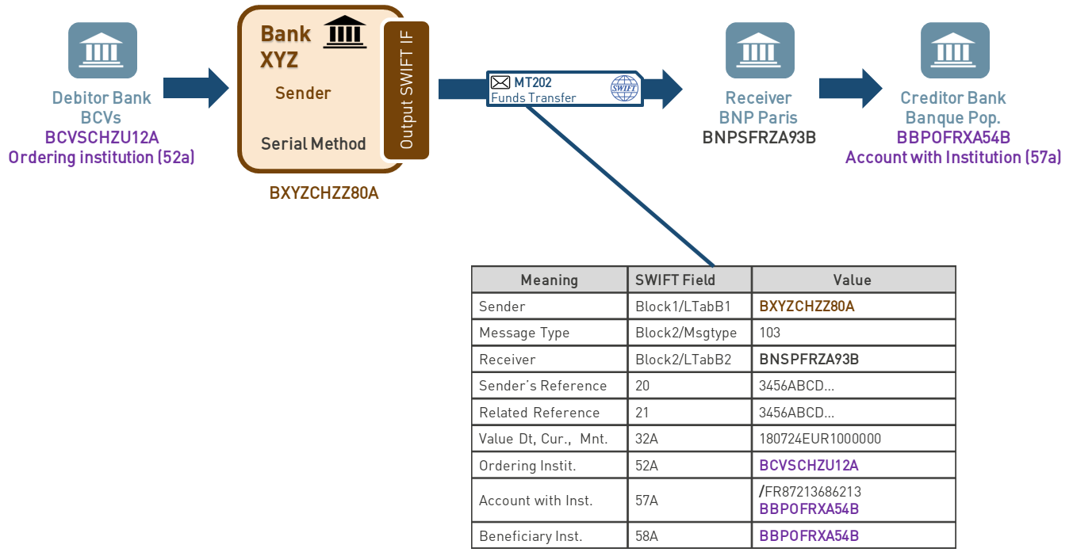
MT202 - General Financial Institution Transfer

Slide 169
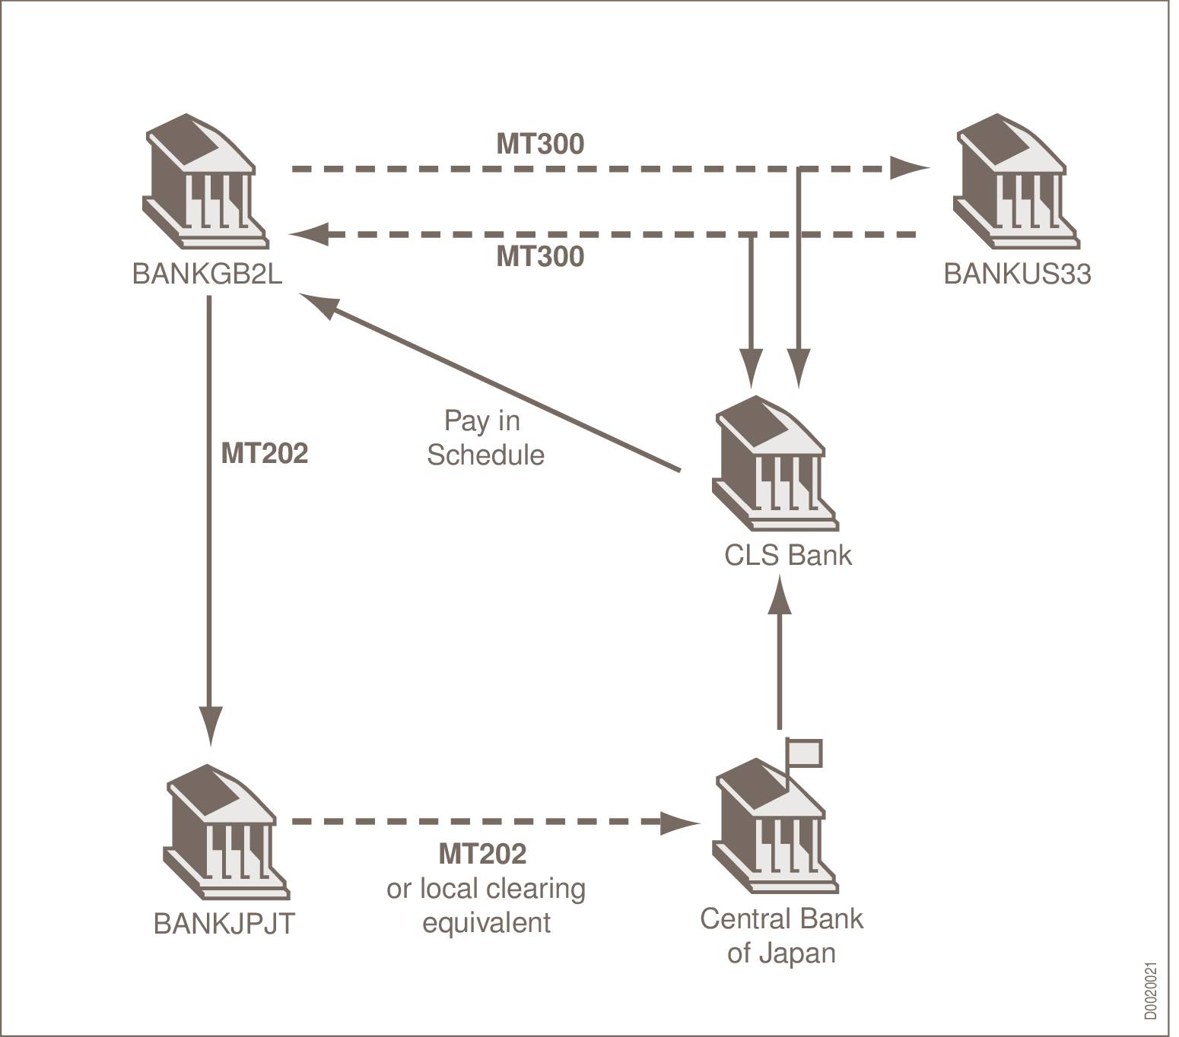
MT202 Example
On 5 January, a CLS settlement member (BANKGB2L) receives an instruction from CLS Bank to fund JPY 5,000,000 by 07.00 AM CET to CLS Bank.
BANKGB2L sends an MT 202 to their JPY nostro correspondent (BANKJPJT), indicating that the funds need to be credited to CLS Bank by 07.00 AM CET.

Slide 170
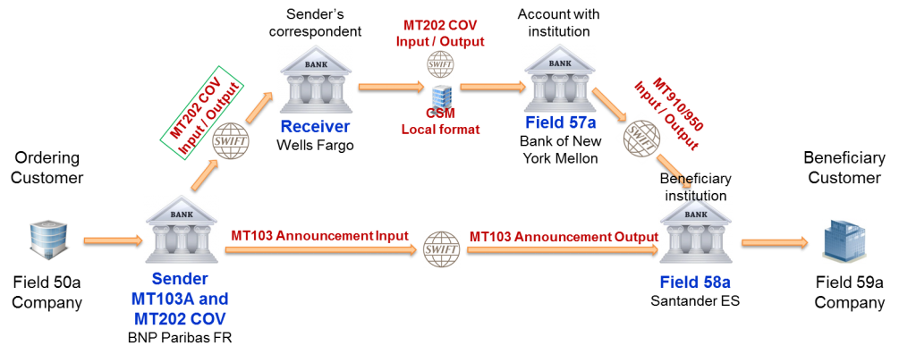
COVER PAYMENT
A cover payment involves two distinct message streams (MT 103 & MT 202). ➢MT 103 - Direct payment order to the Beneficiary's Bank, and. ➢MT 202 – Bank-to-bank order(s) to Intermediary Bank(s) to cover the Originator's.

Slide 171

MT 202 COV as cover of MT 103: Example
Value 27 May 2009, Mr. Big orders Bank A, Brussels to pay an invoice with number 1234 of USD 10,500.00 to Mr. Small who has an account 987654321 with Bank B, London.
Bank A processes this transaction through cover method by sending:
A customer credit transfer message MT 103 to Bank B, using reference 090525/123COV.
A message MT 202 COV with reference 090525/124COV for the USD payment to its USD correspondent Bank C, New York for credit of Bank B, London on their account 123444555 at Bank D, New York.

Slide 172

Import LC Swift Message Used

Slide 173

Export LC Swift Message Used

Slide 174
Guarantee

Slide 175
Guarantee - Agenda
Definition
Facility Type
Types of Guarantee
Guarantee Life Cycle and Activities
Demand/Presentation/Payment

Slide 176
Guarantee
What is Guarantee ?
Demand guarantee or guarantee means any signed undertaking, however named or described, providing for payment on presentation of a complying demand
Demand - Signed document by the beneficiary demanding payment under a guarantee
Complying presentation – Guarantee Terms, URDG Rules and Banking Practice
It is an arrangement between three parties :
1. The Applicant i.e. the party requesting the Guarantee
2. The Guarantor i.e. the bank that guarantees the agreed compensation amount to be paid in the event of a failure to meet contractual obligations
3. The Beneficiary i.e. the party for whom the Guarantee is issued

Slide 177
Guarantee
Facility Types
Non Fund Based - Products where outgo of FUNDS is not involved and Bank collect Fees, Commission for utilization. Example : Letter of Credit and Guarantee (Promise of Payment)
Fund Based - Products involving OUTGO of funds and bank collect interest. Examples : Term Loan (> 3 Years , Asset acquisition and business set up), Demand Loan (<3 Years – Short Tenure)
Notes:
Reference :
What are Fund based and Non-Fund based loans? - Regular Banking
Fund-based and Non-fund Based Credit Limits (fundingoptions.com)

Slide 178
Guarantee
Similarity and Difference with Letter of Credit
Similarity :
Both are non fund based facility
Involve documents for presentation
Expiry and presentation date

Slide 179
Guarantee
Similarity and Difference with Letter of Credit
Difference :
Activity which leads to payment
Liability for Bank : Primary in L/C and Secondary in Bank Guarantee
Parties Involved : Applicant not a party in L/C
Application areas : L/C for International trade , Guarantee for contract formality
Activation of Instrument : Inherent active for LC, whereas invocation is raised under BG
Applicable Rules : UCP 600 vs URDG 758

Slide 180
Guarantee
Guarantee Types ?
In General : Direct Guarantee , Indirect Guarantee
Purpose of a Guarantee :
Bid Bond Guarantee- When a company invites you to a tender, it will often require the tender bid to be accompanied by a specific Guarantee to cover the risk that the company submitting the tender will not abide by its offer, will not sign the contract if awarded to it, or will not submit the required performance Guarantee.
Performance Guarantee- A performance Guarantee is used to secure the Applicant/Instructing Party’s fulfilment of its contractual obligations towards the Beneficiary. The Guarantor undertakes to pay compensation up to a certain amount to the Beneficiary in case the Applicant/Instructing Party fails to deliver the goods or to carry out certain work.

Slide 181
Guarantee
Payment Guarantee - The purpose of a payment Guarantee is to cover the Applicant/Instructing Party’s ability to meet its payment obligations and the most common type covers the buyer’s obligation to pay for goods received or services rendered.
Advance Payment Guarantee – The purpose is to ensure the repayment of an advance which the Applicant/Instructing Party of the Guarantee has received or will receive for a delivery or for when a certain work is executed.
B/L Letter of Indemnity - This specific type of Guarantee is used to authorise a transport carrier or its agents, to release a specified cargo to a consignee named in the bill of lading without the surrender of the original document.

Slide 182
Guarantee
Direct Guarantees
By far the most common way to issue a Guarantee, as these are issued by the Guarantor directly the Beneficiary, who must present demand for payment direct to the Guarantor. This demand can be issued by letter, telecommunications, or via SWIFT. In this instance, the Guarantee is issued by the Applicant’s bank and forwarded to the Beneficiary through its bankers.
The advising party is not obligated to the Beneficiary under the Guarantee – it merely acts as a kind of ‘post office’.

Slide 183

Direct Guarantee
Seller’s bank bears no responsibility here

Slide 184
Guarantee
Indirect Guarantees
The Beneficiary receives a bond issued by a bank in its own country. This is usually its own bank, although it can be originally issued by the Applicant. In this case, it is called a Counter Guarantee.
In practice, the Applicant’s bank issues the Counter Guarantee to the Beneficiary’s bank and instructs it to issue its own Guarantee to the Beneficiary.

Slide 185

Indirect Guarantee

Slide 186

Guarantee
Guarantee Life Cycle

Slide 187
Parties involved in a Guarantee Transaction
Referring to Guarantees incorporating URDG 758 Article 2 :
Advising party: “The party that advises the Guarantee at the request of the Guarantor.” This will often either be a correspondent of the Guarantor or the bank that has a relationship with the Beneficiary.
Applicant: “The party indicated in the Guarantee as having its obligation under the underlying relationship supported by the Guarantee.”
Beneficiary: “The party in whose favour a Guarantee is issued.”
Counter-Guarantor: “The party issuing a counter-guarantee, whether in favour of a Guarantor or another Counter-Guarantor, and includes a party acting for its own account.” In most cases, the Guarantor is the bank of the Applicant and/or Instructing Party.
Guarantor: “The party issuing a Guarantee.” In most cases, the Guarantor is the bank of the Applicant or Instructing Party.
Presenter: “A person who makes a presentation as or on behalf of the Beneficiary or the Applicant, as the case may be.” When the Beneficiary presents a demand directly to the Guarantor, the Beneficiary becomes the presenter.

Slide 188
Guarantee Demand/Presentation/Payment
Demand/presentation: URDG 758 makes a clear distinction between demand and presentation (article 2). A demand is a demand for payment, while a presentation is to be understood in a broader sense and may also serve other purposes e.g. presentation of a document reducing the amount of the Guarantee. In other words, a demand is always a presentation, but a presentation is not always a demand.
When a demand is made to the Guarantor, the Guarantor shall, within five business days following the day of presentation, examine the demand and determine if it is a complying demand (article 20(a)).
When it is necessary to make a demand under the Guarantee, URDG 758 has several provisions to regulate the process.
Notes:
ICC-URDG-758.pdf (cipcic-bragadin.com)

Slide 189
Supply Chain Finance

Slide 190
Supply Chain Finance- Agenda
Definition
Type of Products

Slide 191

Supply Chain Finance (SCF)
Supply chain finance (SCF) or reverse factoring is an arrangement between the buyer, the supplier, and a financier or factor by which the payment for the receivables by the supplier is received in advance, thereby benefiting both the buyer and the supplier.

Slide 192



Products

Slide 193

Receivable Finance
Receivables finance is a term that describes several different techniques a business can use to raise funds against the amounts owed to it by its customers in outstanding invoices.
Sellers of goods and services sell individual or multiple receivables (represented by outstanding invoices) to a finance provider at a discount (synonyms include Receivables Finance, Receivables Purchase, Invoice Discounting).

Slide 194
RF process
Seller sells goods to buyer
Seller issues an invoice to the buyer
Seller sells the invoice to the bank
Bank pays seller a cash advance of 70%-90% of the value of the invoice
Buyer pays the invoice amount to bank
Bank sends the balance to the seller with fees deducted.

Slide 195
Advantages and Disadvantages
Advantages
Accounts receivable financing allows companies to get instant access to cash without jumping through hoops or dealing with long waits associated with getting a business loan.
When a company uses its accounts receivables for asset sales it does not have to worry about repayment schedules.
When a company sells its accounts receivables it also does not have to worry about accounts receivable collections.
Disadvantages
Although accounts receivable financing offers a number of diverse advantages, it also can carry a negative connotation.
Receivable financing can cost more than financing through traditional lenders, especially for companies perceived to have poor credit.
Businesses may lose money from the spread paid for accounts receivables in an asset sale.

Slide 196

Forfeiting
Forfaiting is a method of obtaining medium-term funds for a business involved in international trade. The process consists of a company engaged in exporting the capital goods, selling foreign accounts receivables like promissory notes or bills of exchange, and immediately receiving the financing.

Slide 197
FF Process flow
The seller will contact Swiss Forfeit (SF) looking for their services.
SF will ask the seller for details about the exchange and request any necessary documents.
The financial institution accepts the foreign accounts receivables from the seller.
SF will outline the terms and conditions of the agreement, including the goods being purchased and the discount price.
The seller and SF will enter a contract that explicitly states the accounts receivables, purchasing price, the date, and necessary documentation.
The seller will deliver the products or services to the buyer.
SF will pay the seller the agreed-upon fees.
The bank of the importer will then pay SF.
SF will collect the payments from the buyer.

Slide 198
Advantages and Disadvantages
Advantages
Able to finance up to 100% of the contract value
Provides immediate funds
Allows businesses to expand and grow operations through exporting to other nations
The risk is mitigated by involving multiple parties
Flexible funding option
Forfaiting can involve fixed interest rates
Disadvantages
The cost can be higher than other financing options
Not a suitable method for short-term transactions
Primarily used for capital goods
Currency problems make forfaiting unfavorable at times
In some cases, the higher cost can be passed to the buyer
Promissory Notes – A written letter signed by a party stating the intention to pay a specified amount on a specific date.
Accounts Receivables – Claims on money due for sold products or services.
Bills of Exchange is essentially an IOU for goods or services within an outlined amount of time.
Letter of Credit – A guarantee from a bank ensuring the supplier will get paid.

Slide 199

Factoring
Factoring is the most common form of accounts receivable financing for smaller businesses. Under the factoring approach, the borrower sells its receivables to a factoring institution. The receivables are sold at a discount, where the discount depends on the quality of the receivables.

Slide 200
Factoring process flow
Customer places an order to seller.
Agreement is made between the factor and seller.
Sale contract is signed, and goods are delivered to the buyer.
Copy of invoice is sent to factors and the factor prepares some percentage of invoice value.
Monthly statements are sent to buyer by factor.
If any unpaid services are there, follow up is initiated.
Buyer settles invoice before credit period.
Balance percentage (if any) is paid to the client by factor.

Slide 201
Advantages and Disadvantages
Client's credit is covered through advances.
Cash advances.
Collection services.
Provide advice.
Advantages
Better working capital management.
Turnover stocks increases.
Reduces the risk.
Reduction in debts.
Disadvantages
High risk is involved.
Uneconomical for small companies.
Assessing the credit risk.
Lack of professionals.
Non-acceptance of change.

Slide 202

Payable Finance
Payables Finance is a form of Receivable Purchase.
It is a buyer-led programme within which sellers in the buyer’s supply chain can access finance by means of Receivables Purchase.
The technique provides a seller with the option of receiving the discounted value of receivables prior to the actual due date and typically at a financing cost aligned with the credit risk of the buyer.

Slide 203

PF Process flow

Slide 204

Advantages and Disadvantages
Advantages
Account payable is a short-term loan
Most companies prefer to have an extended date for pay off.
It helps the company gather cash for the payment and improves its cash-flow condition.
This method of payment also strengthens the company and its supplier relationship.
Disadvantages
In this process, lots of capital from the suppliers stuck to the business
Extending the payoff period only puts pressure on the supplier’s financial position.
Any delay in the accounts payable payoff can shatter the company and its supplier relationship and cause harm to the long-term business relationship.

